Slide 1
Electricity Coupled with the Heating Sector
Electricity Mismatch Analysis

Slide 2
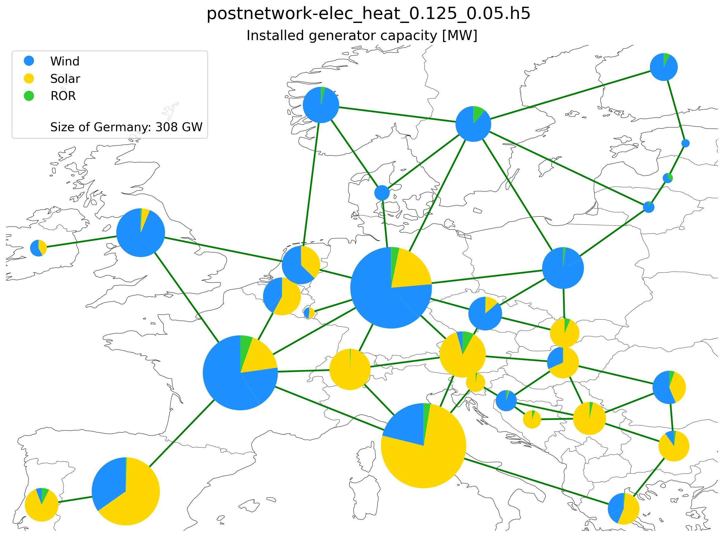
Installed capacity

Slide 3
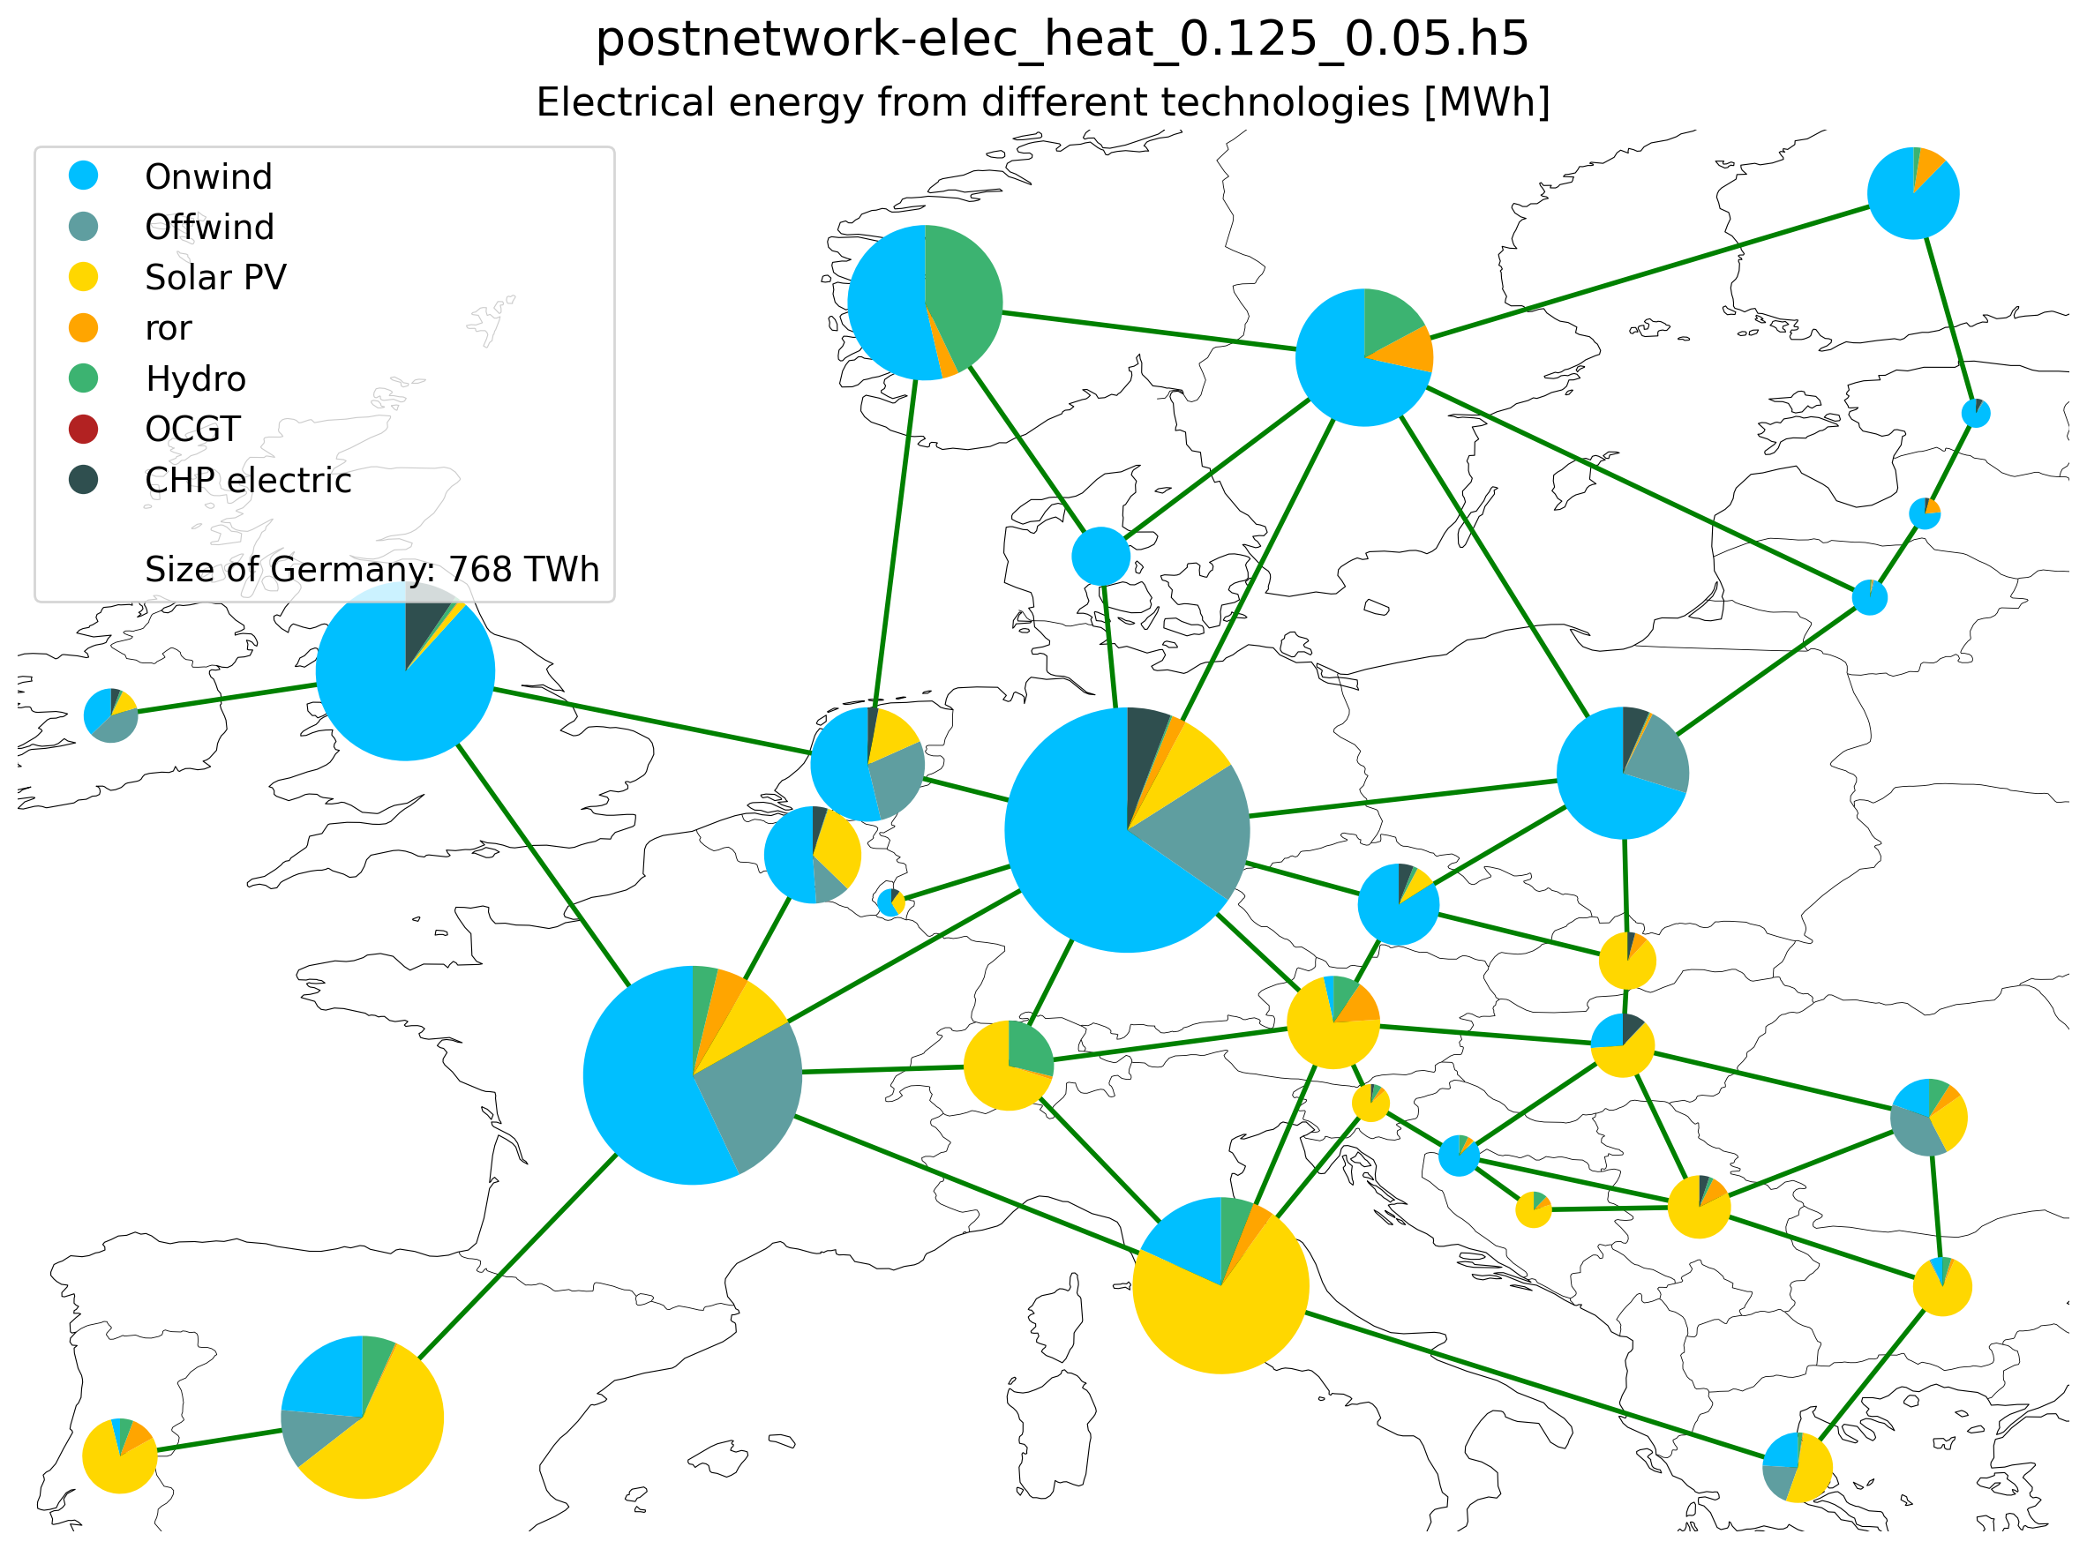
Electricity Supplied by Different Technologies

Slide 4
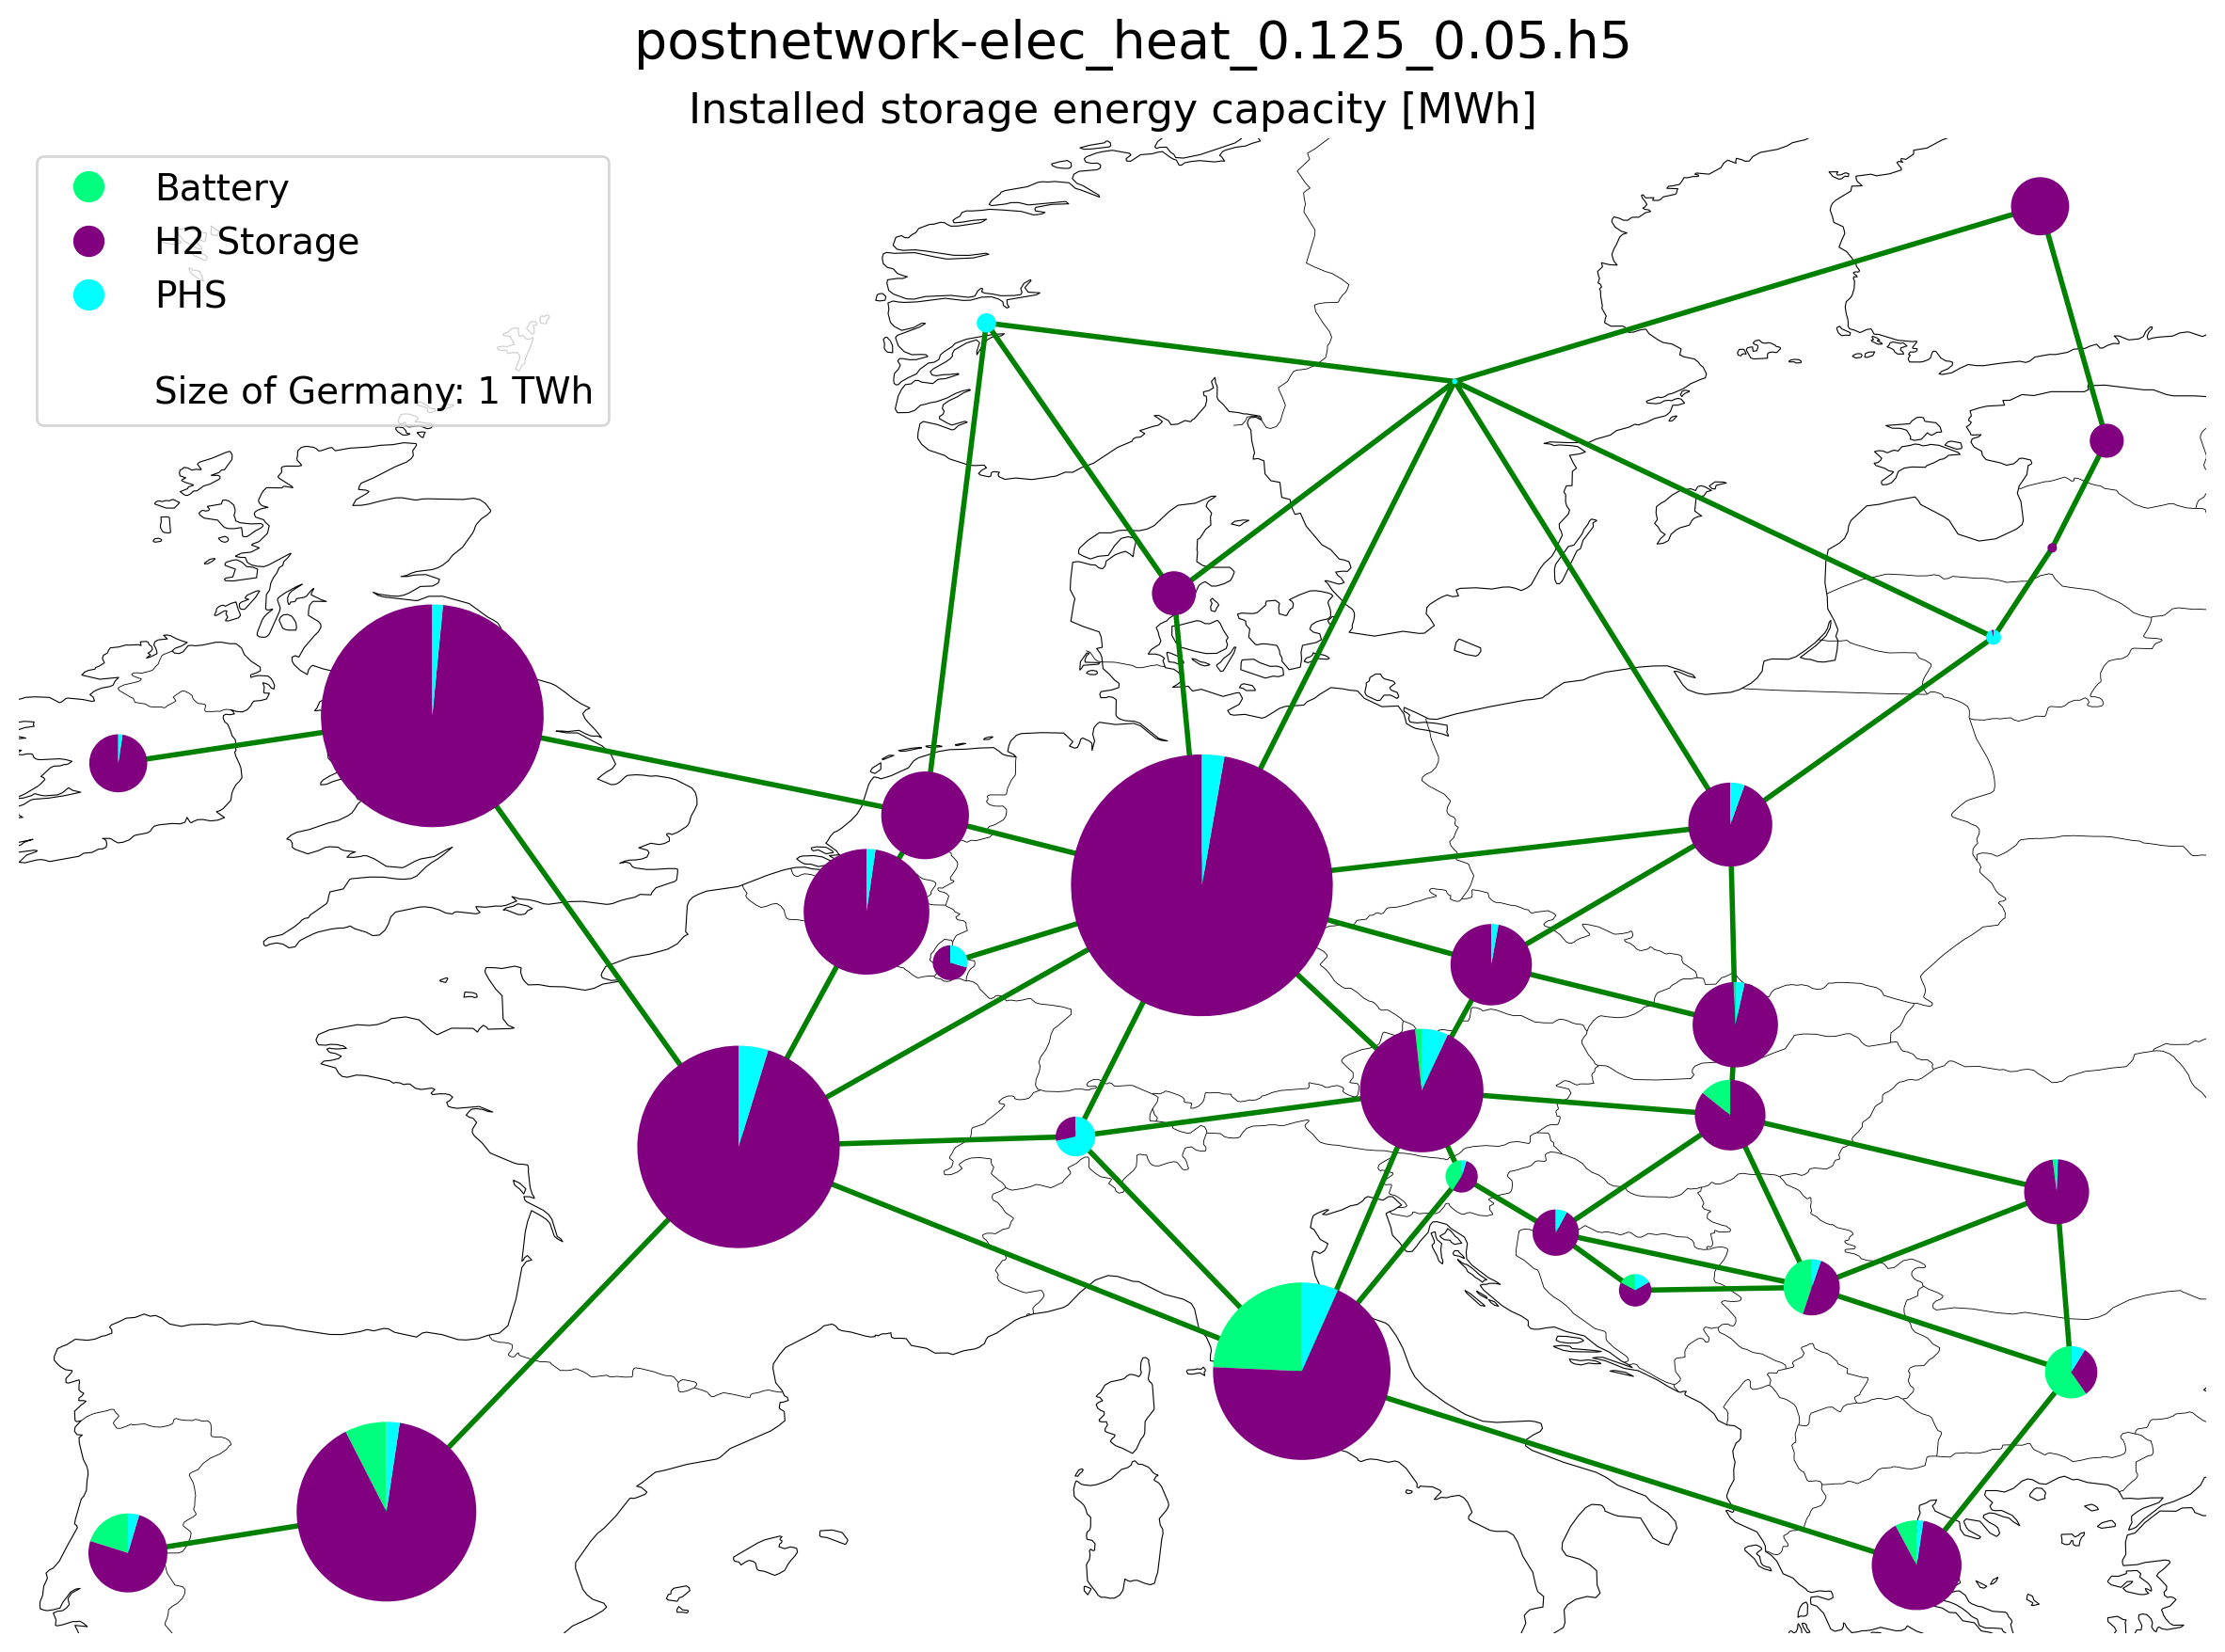
Installed storage (energy capacity)

Slide 5
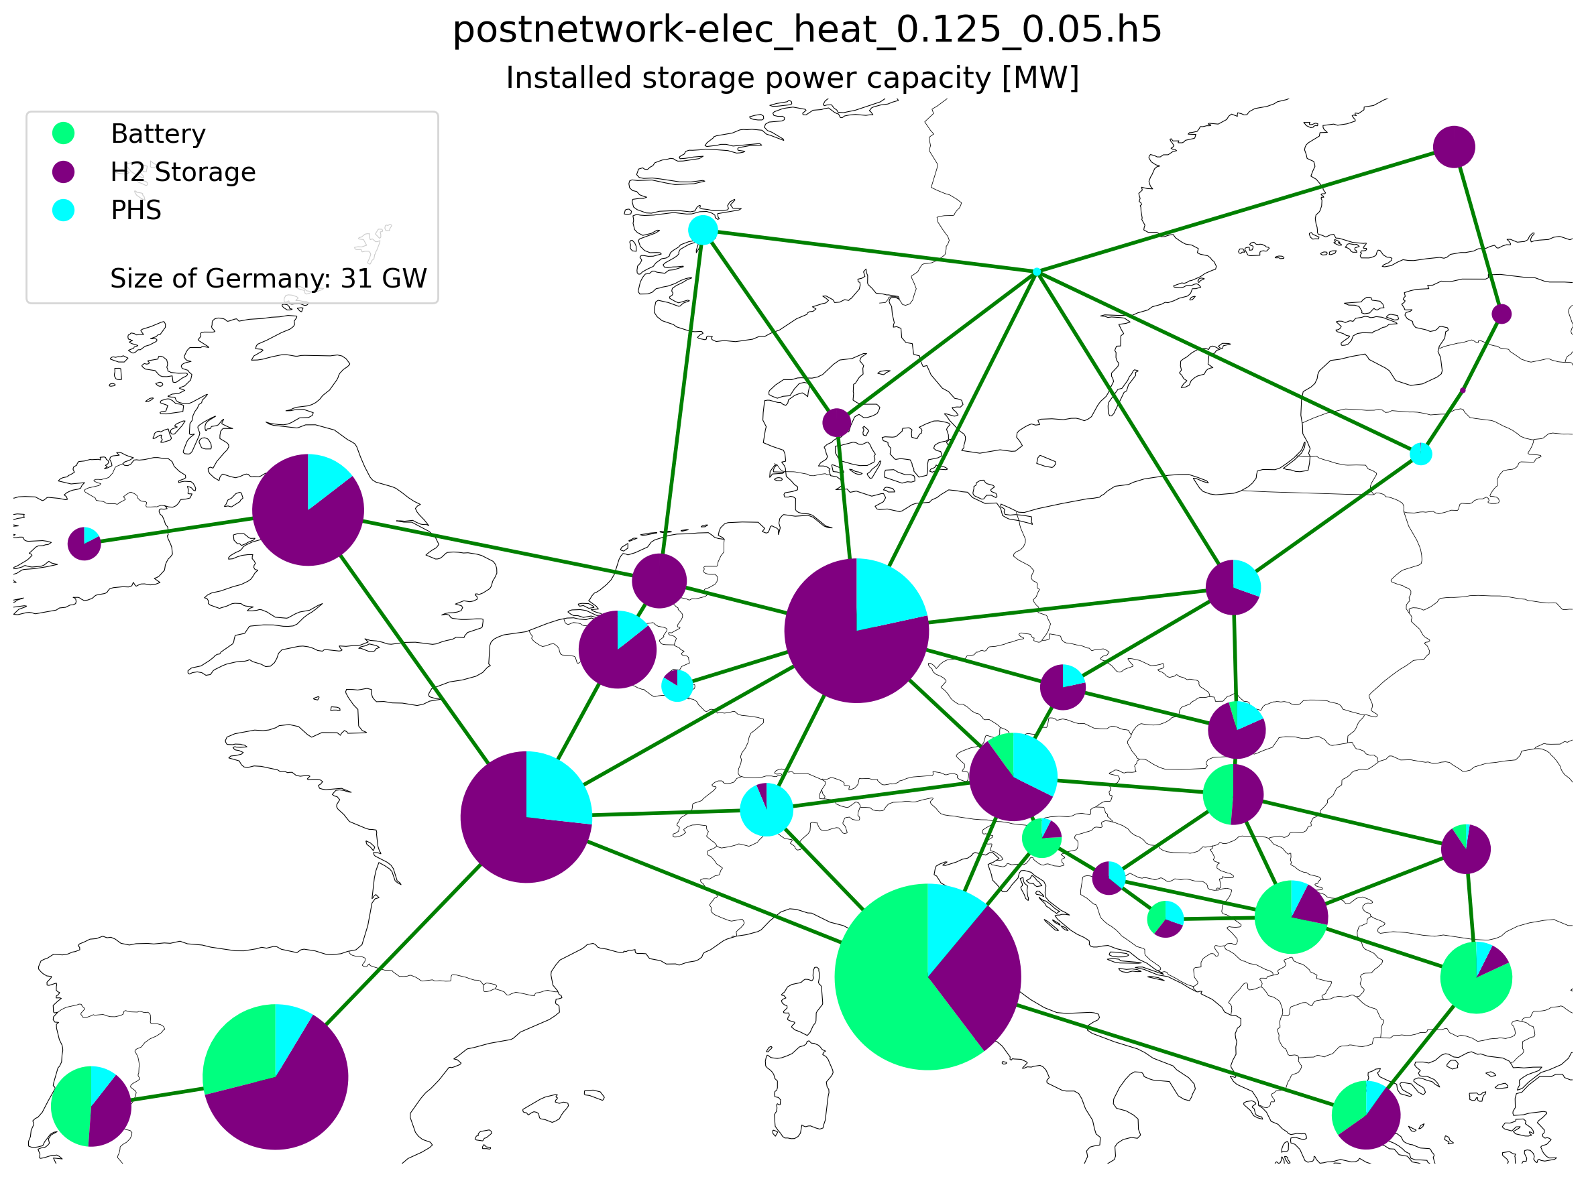
Installed storage (power capacity)

Slide 6
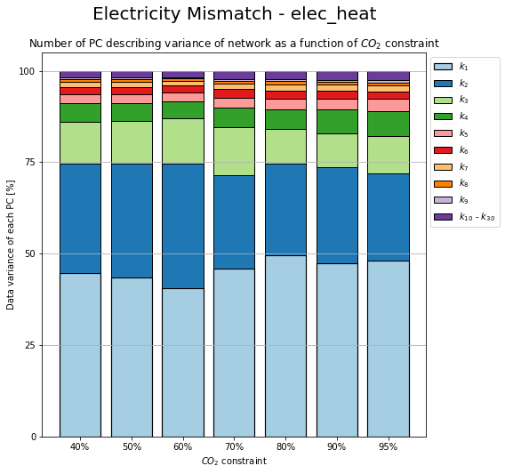
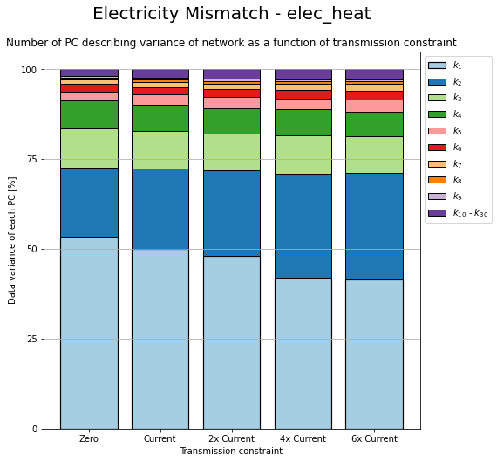
Change in PC due to CO2 and Transmission Constrain

Slide 7
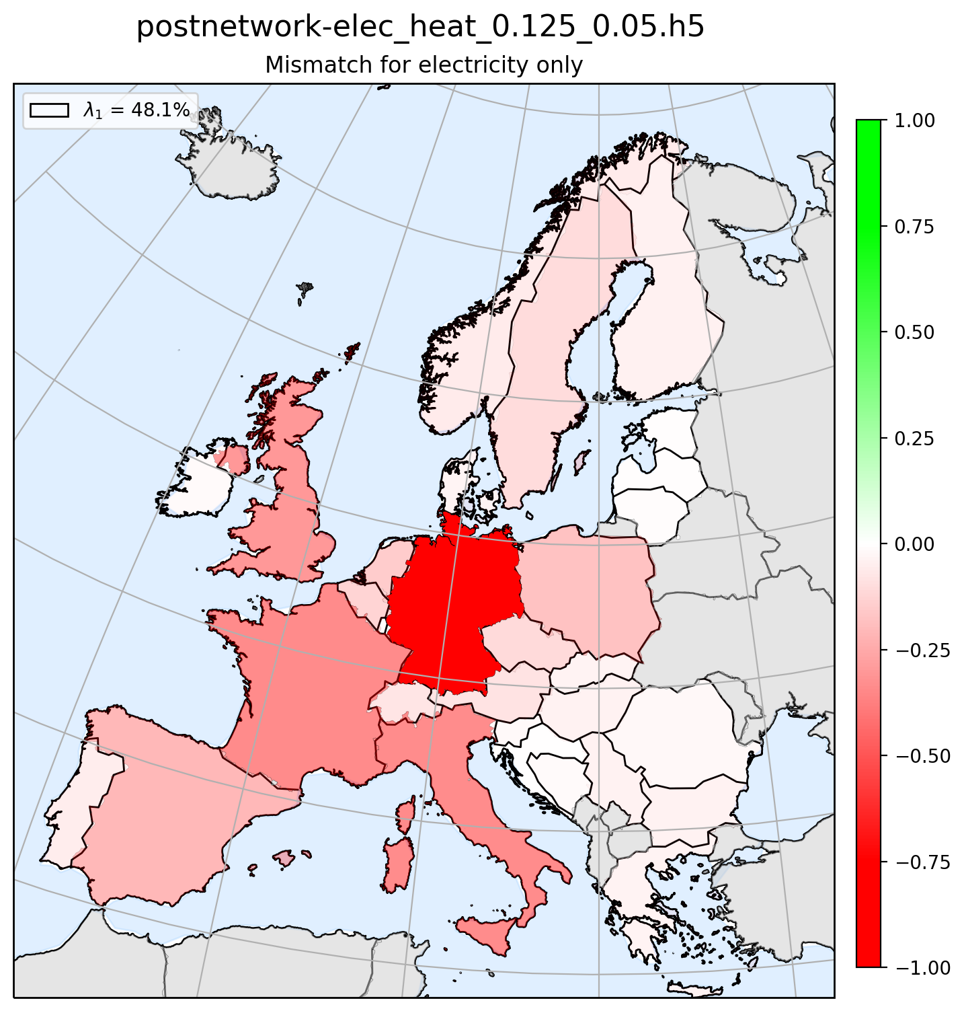
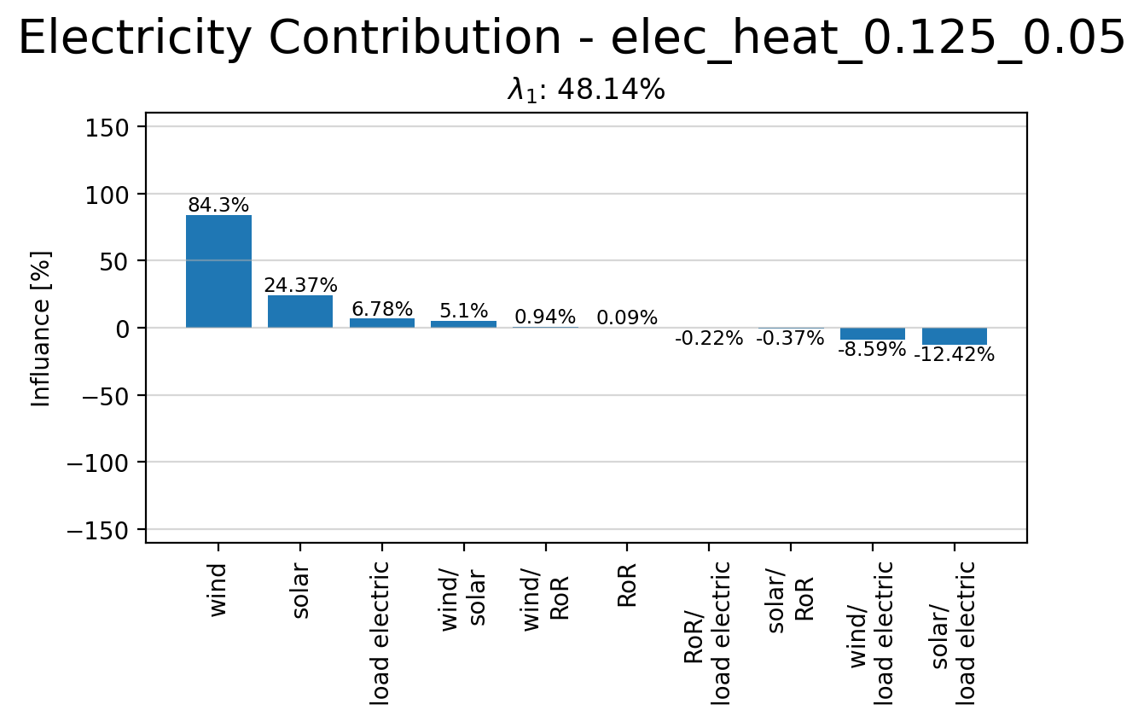
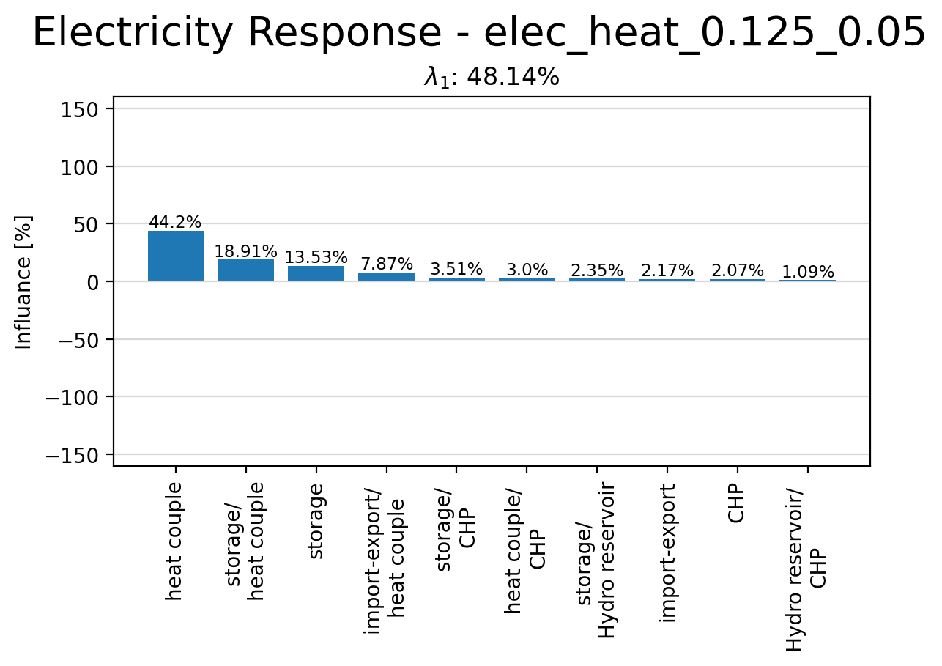
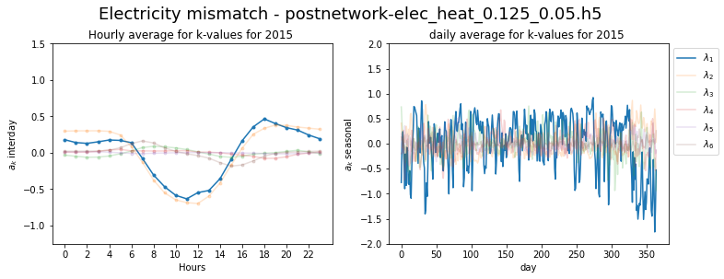
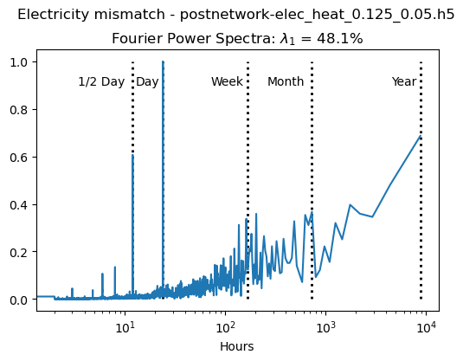
Principle Component 1

Slide 8
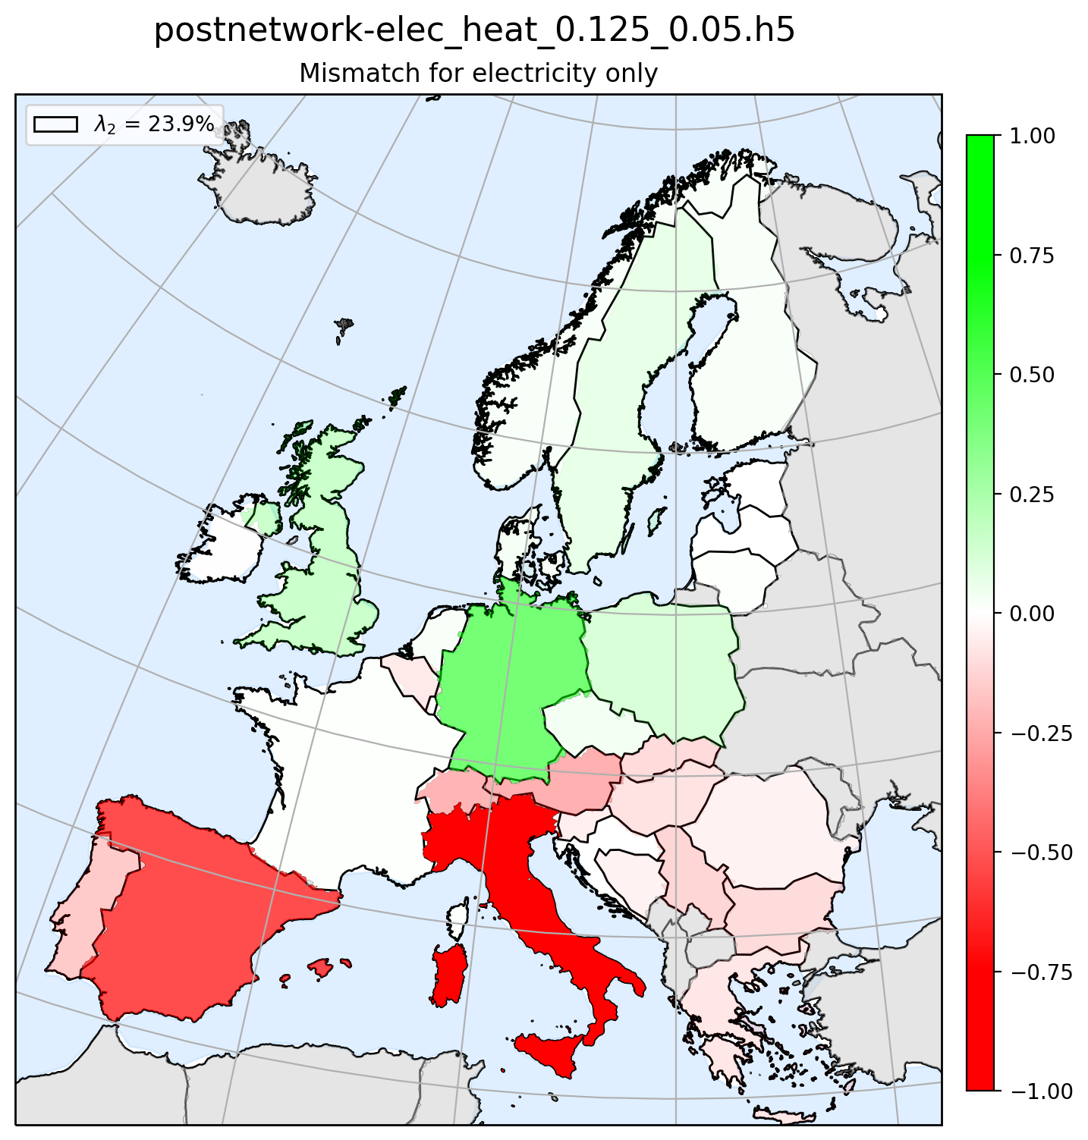
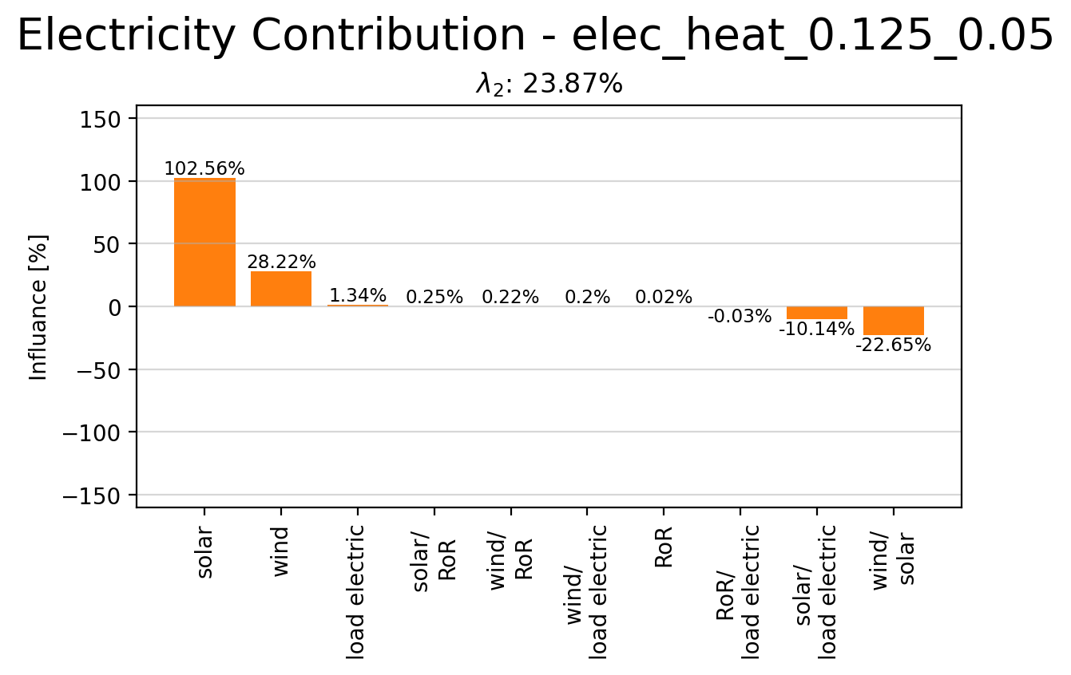
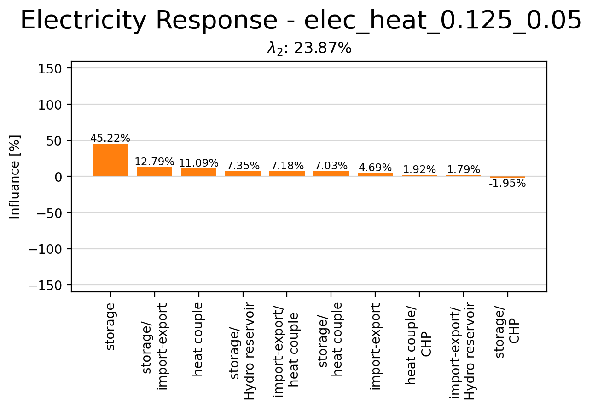
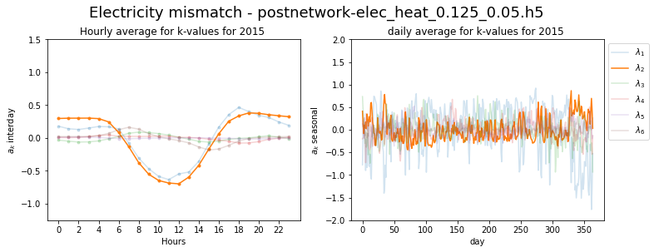
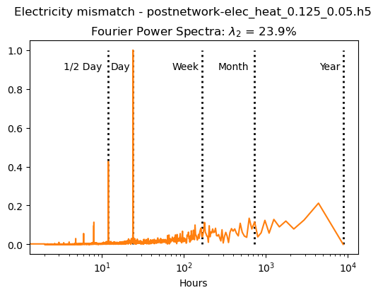
Principle Component 2

Slide 9
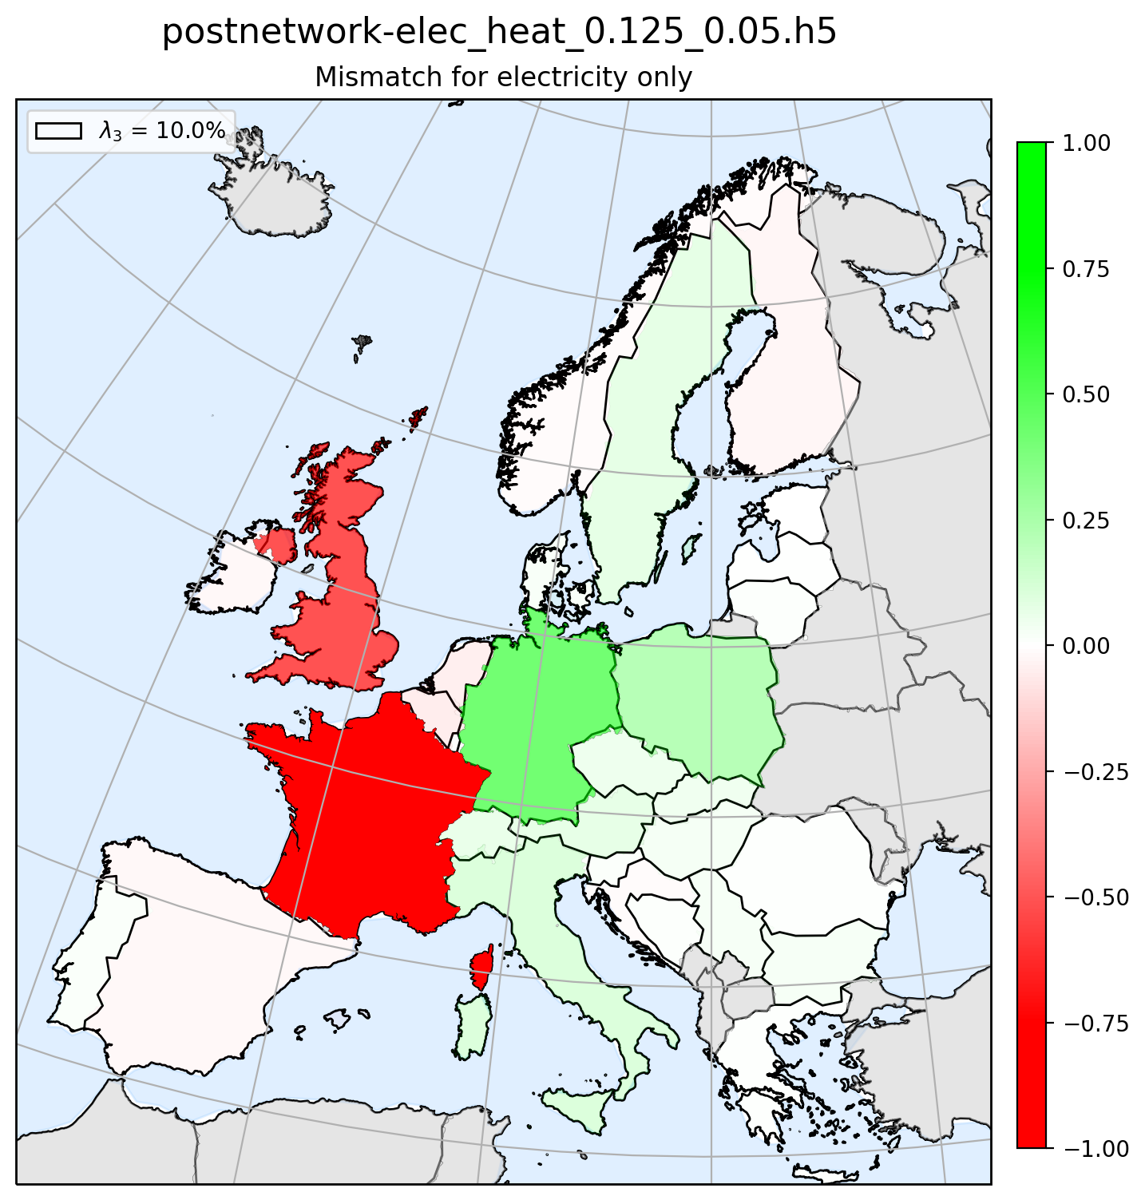
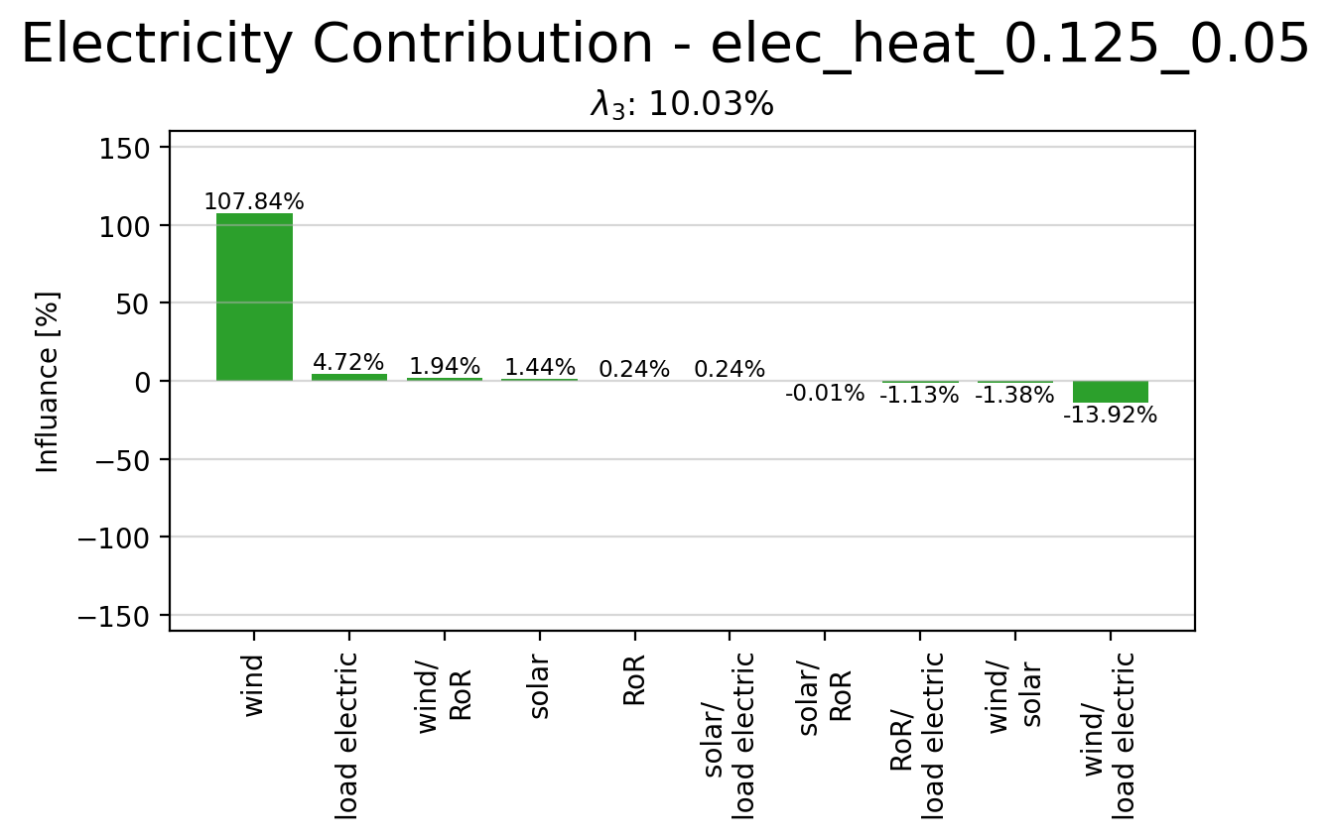
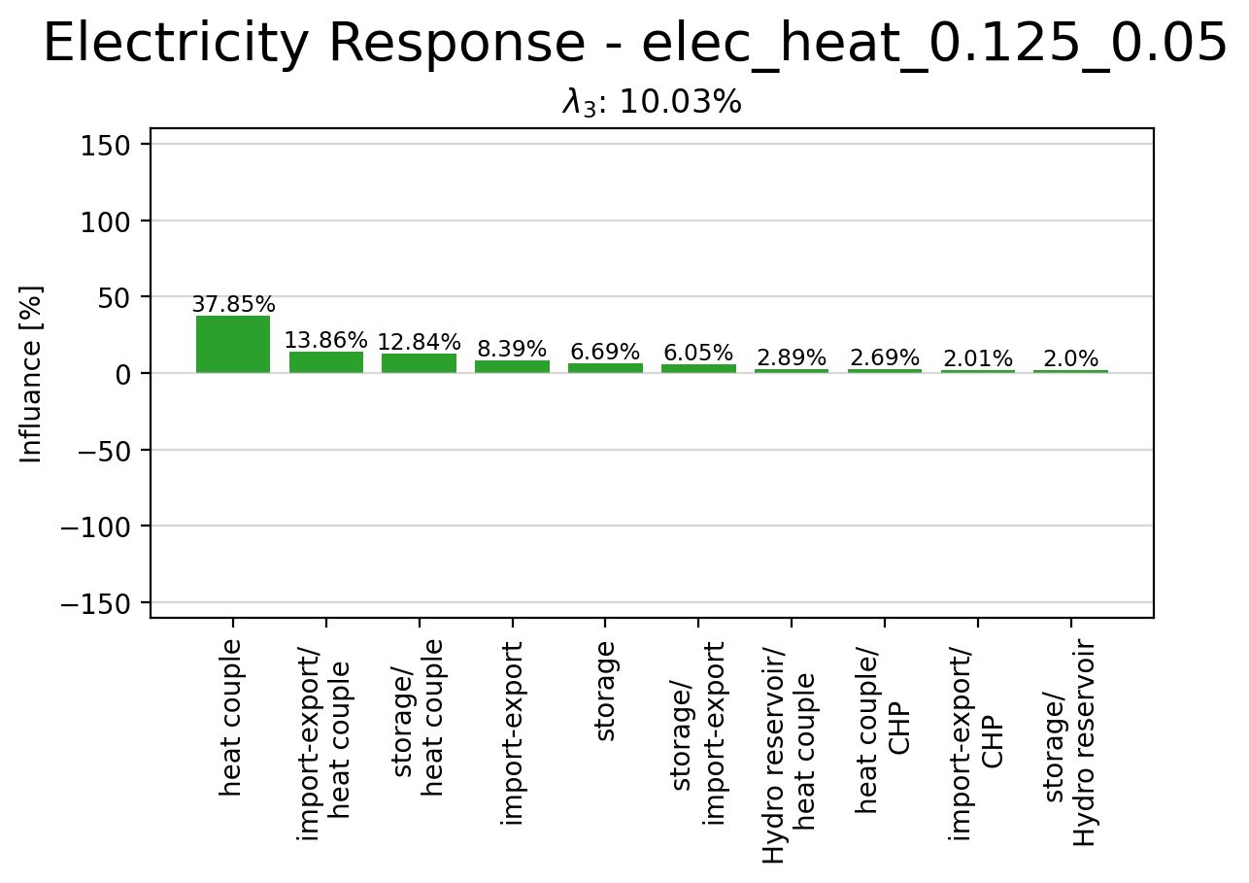
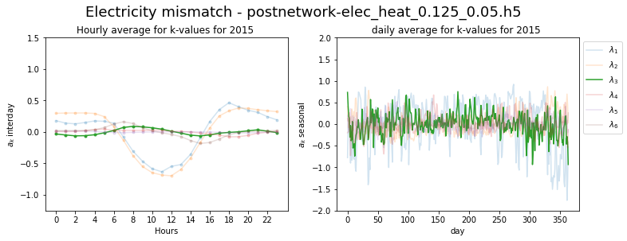
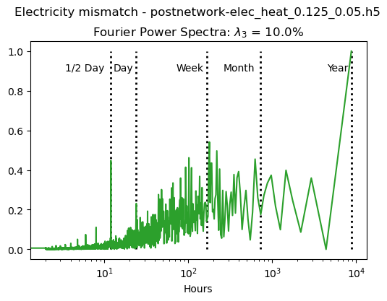
Principle Component 3

Slide 10
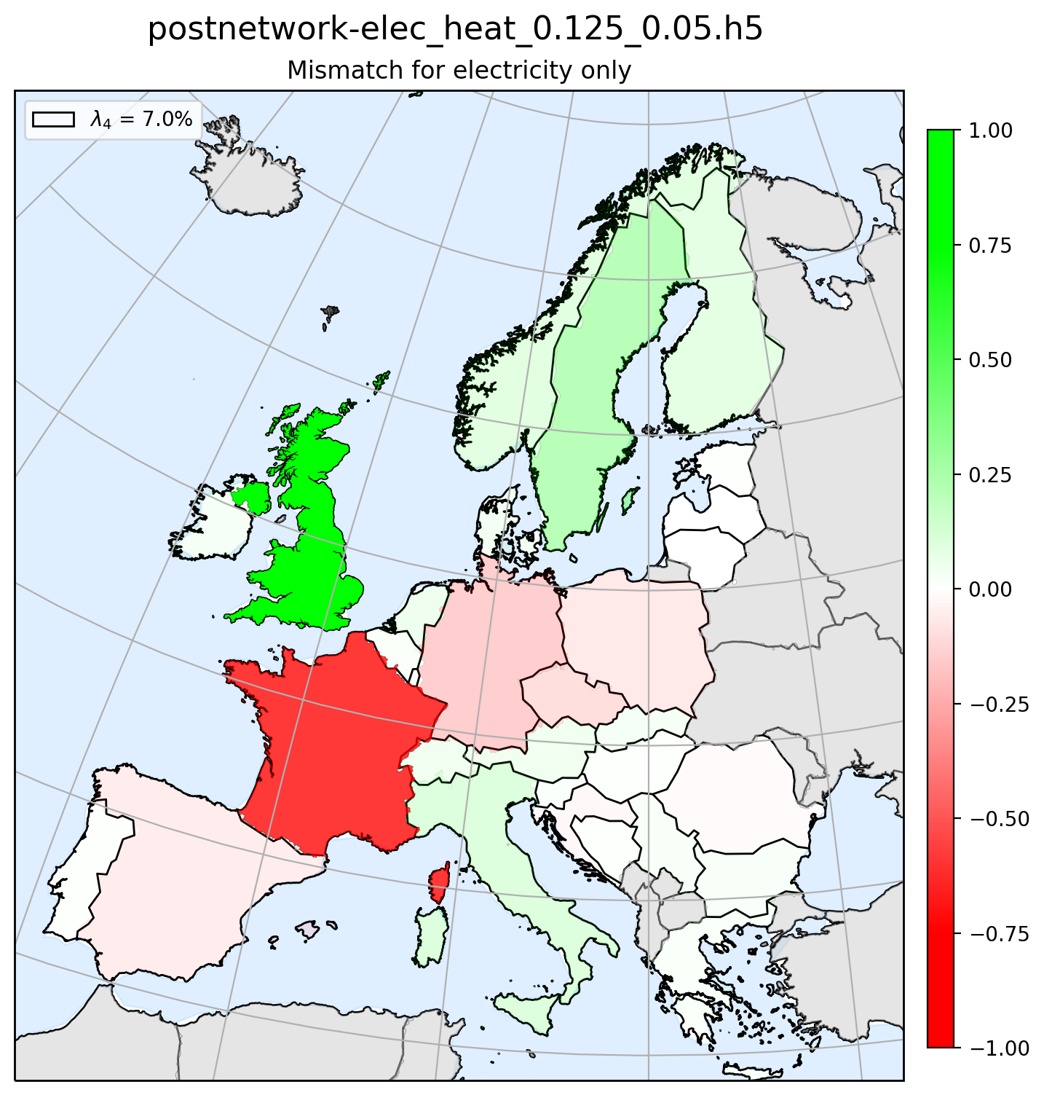
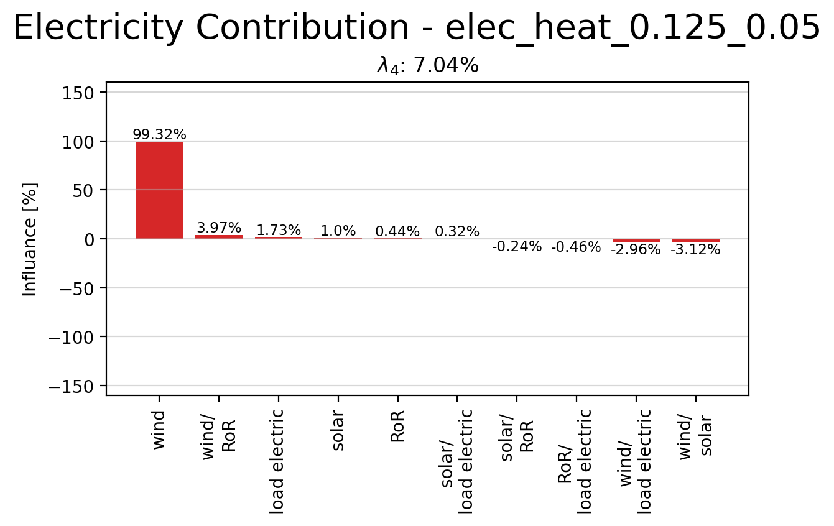
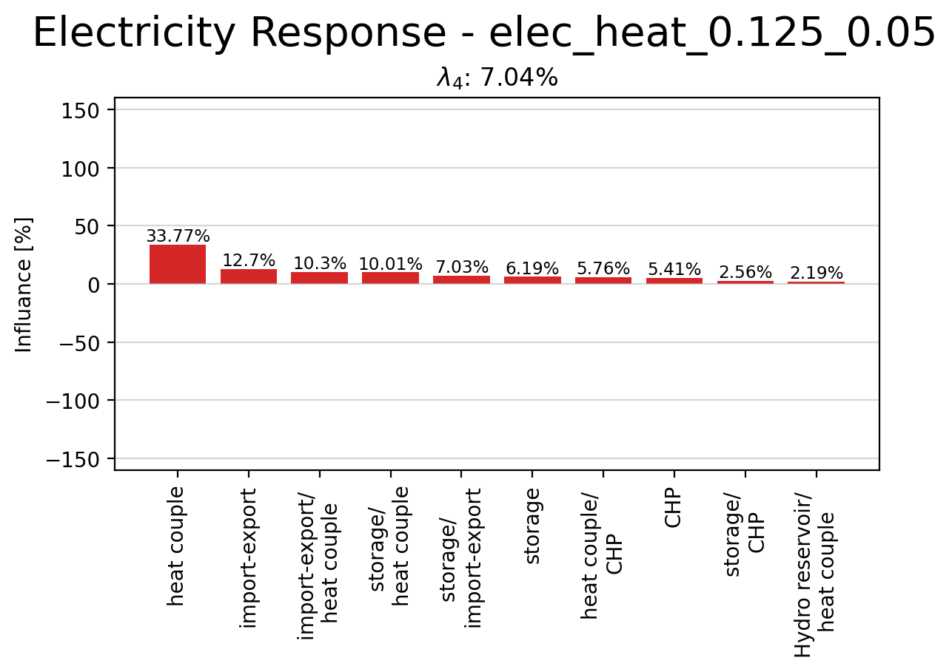
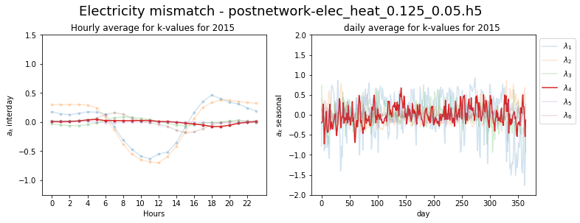
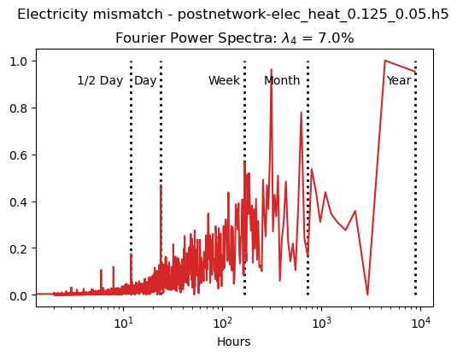
Principle Component 4

Slide 11
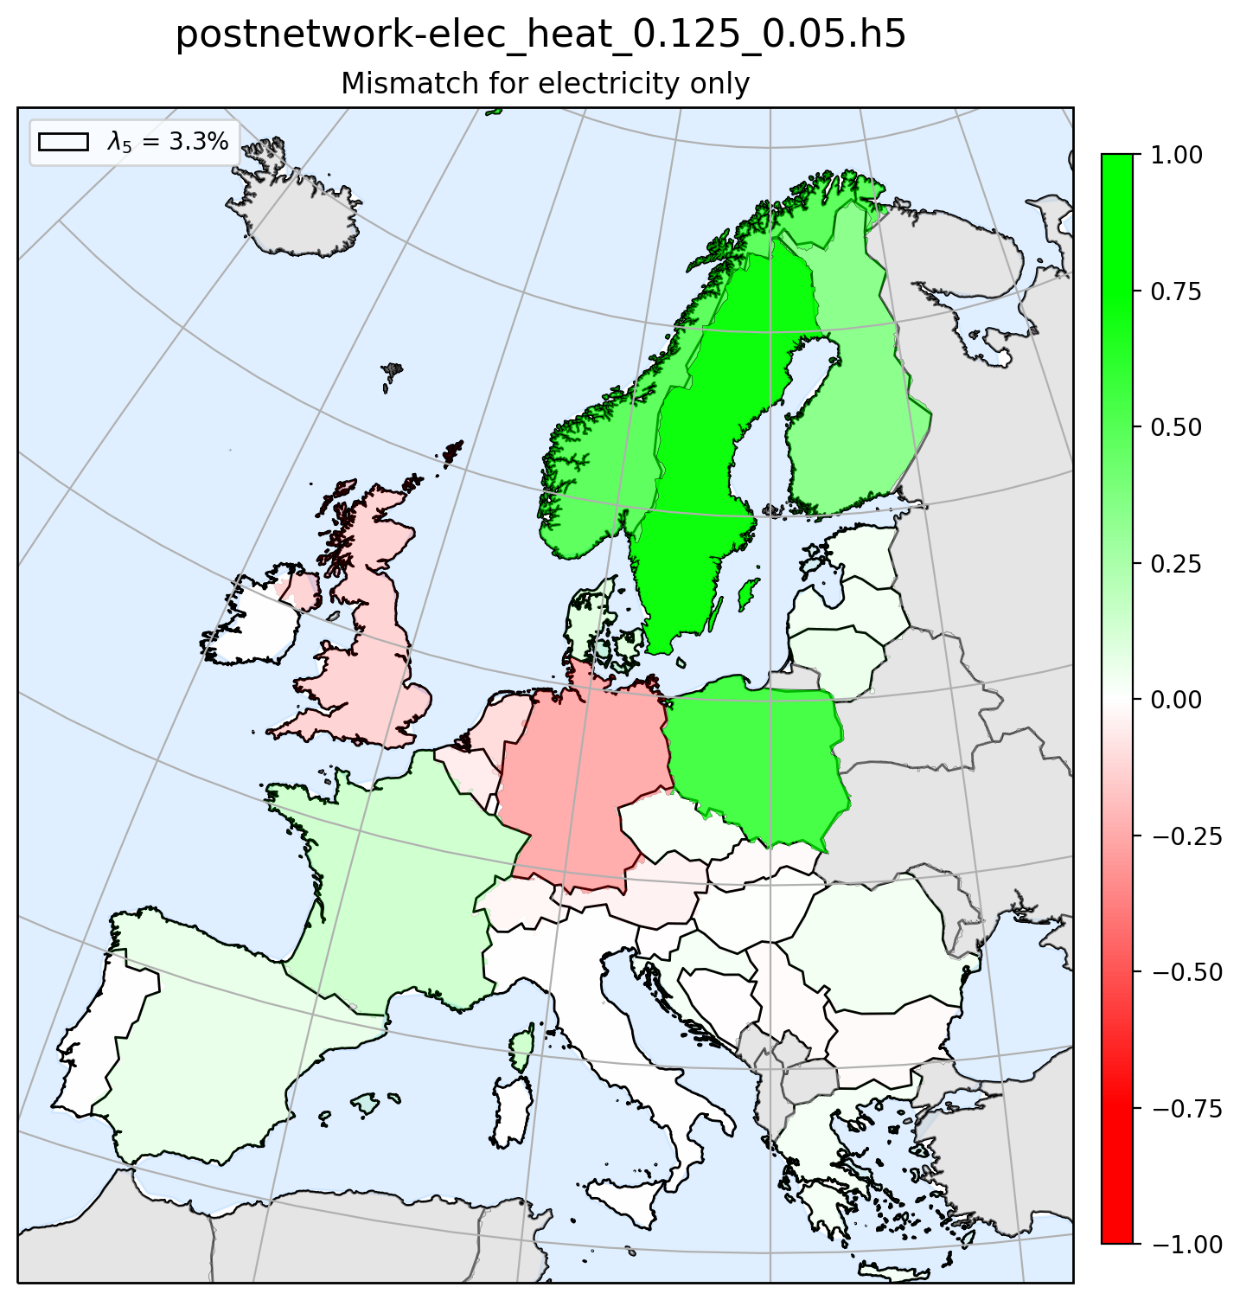
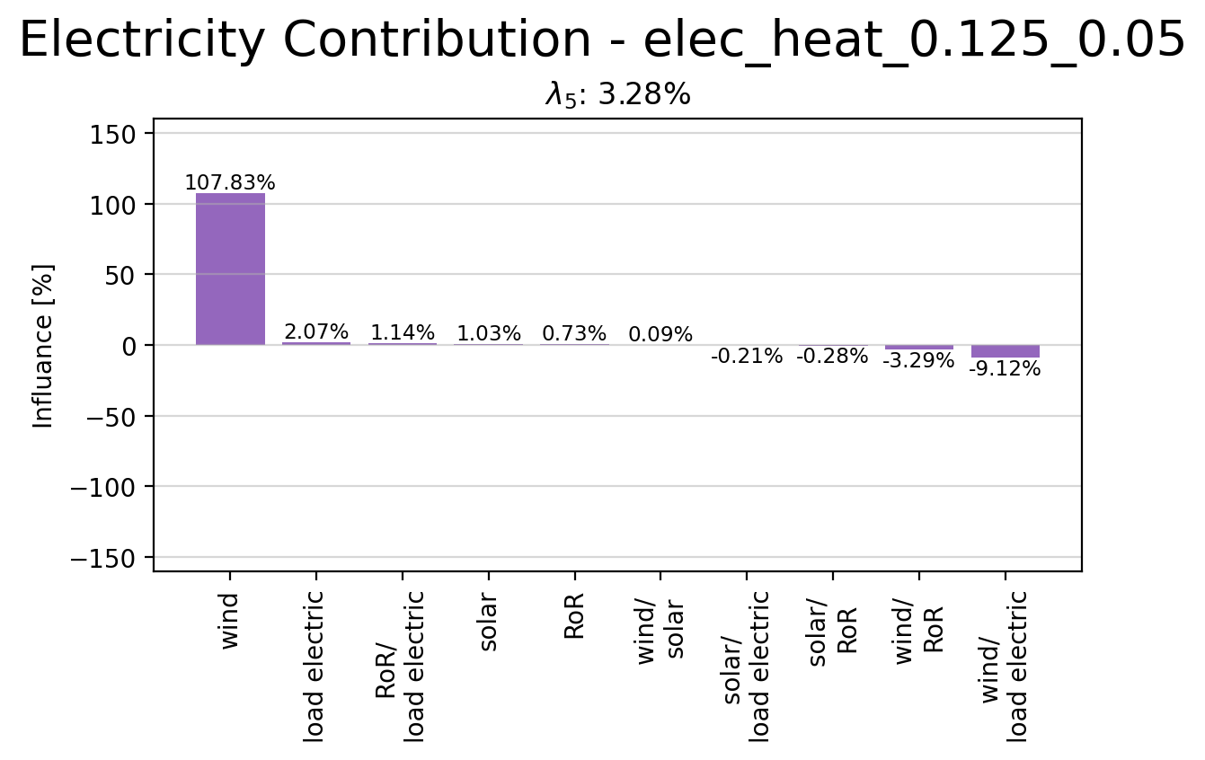
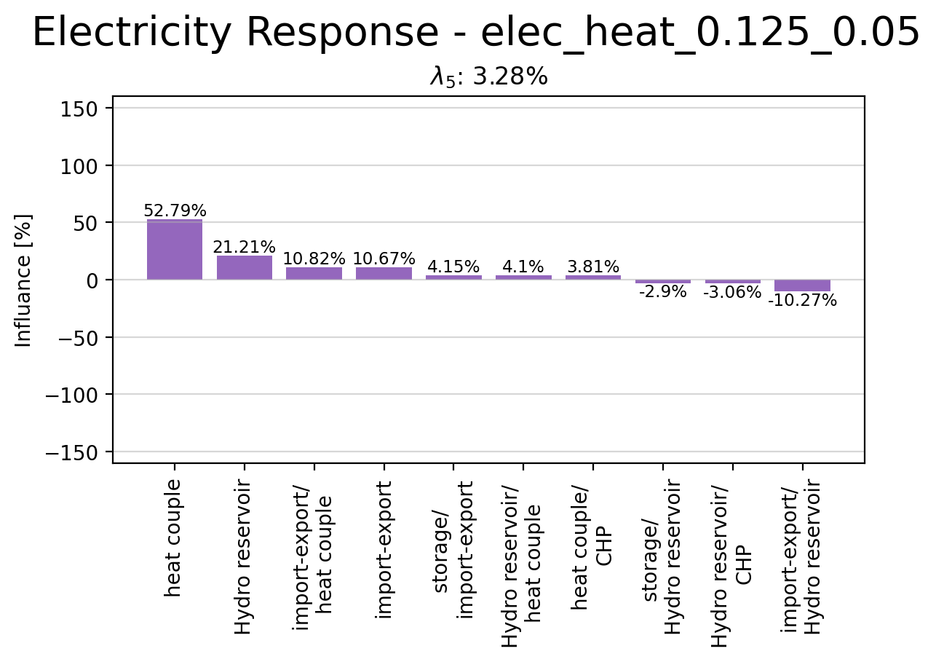
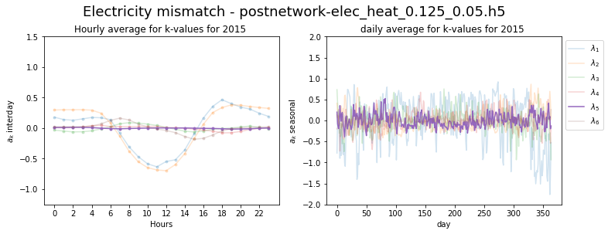
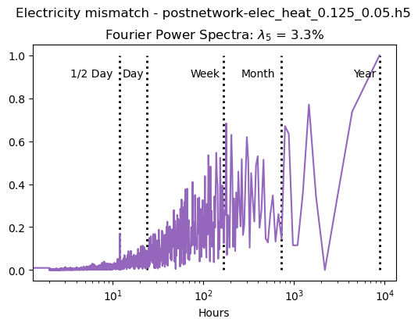
Principle Component 5

Slide 12
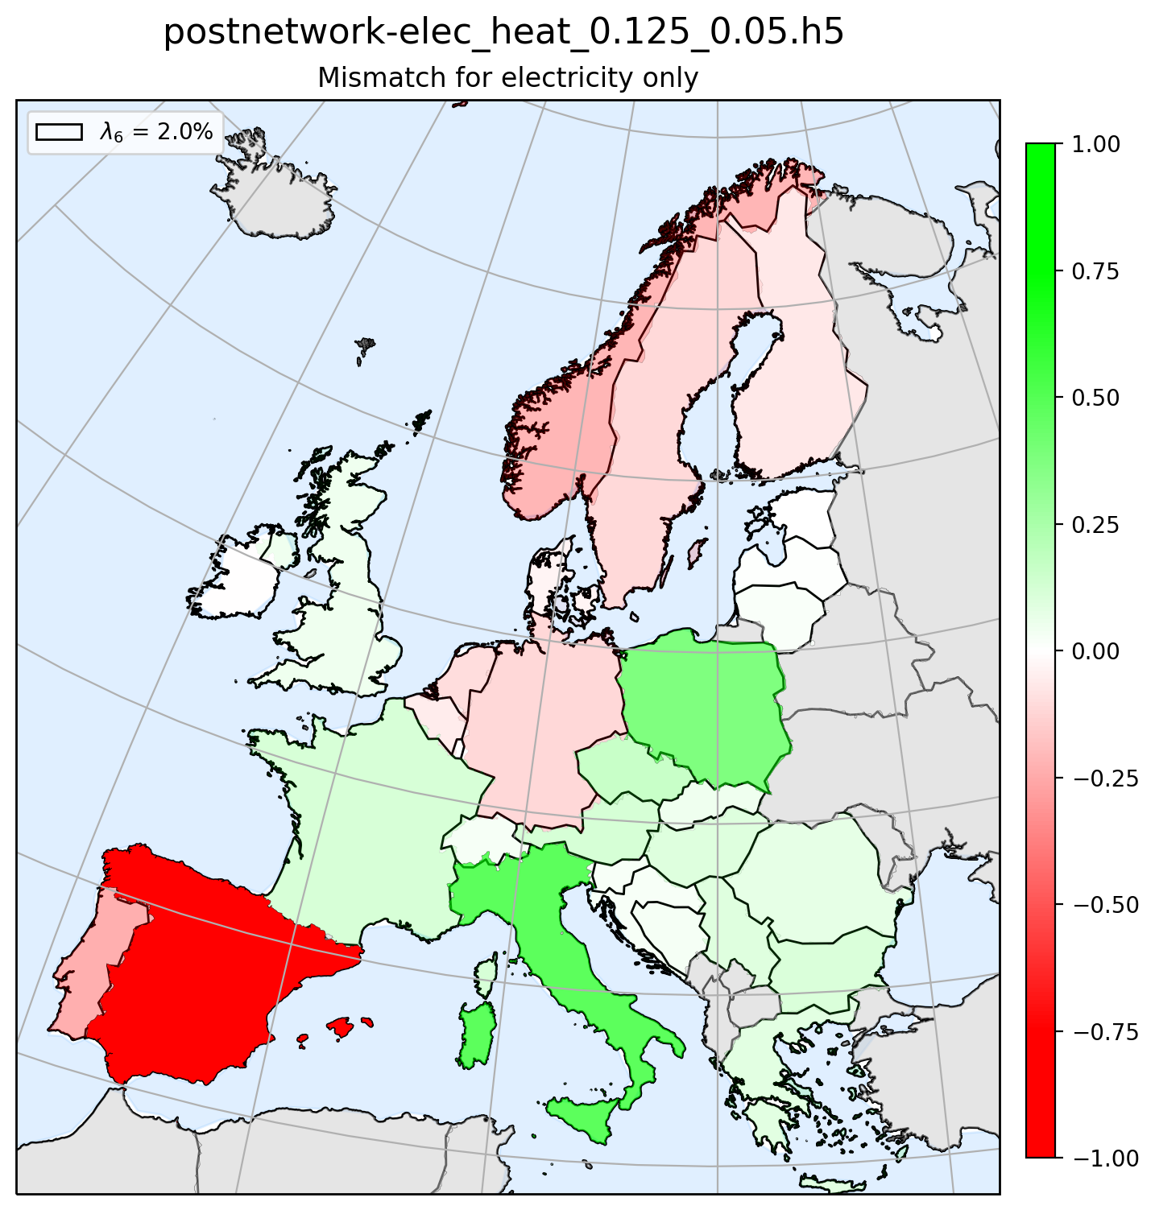
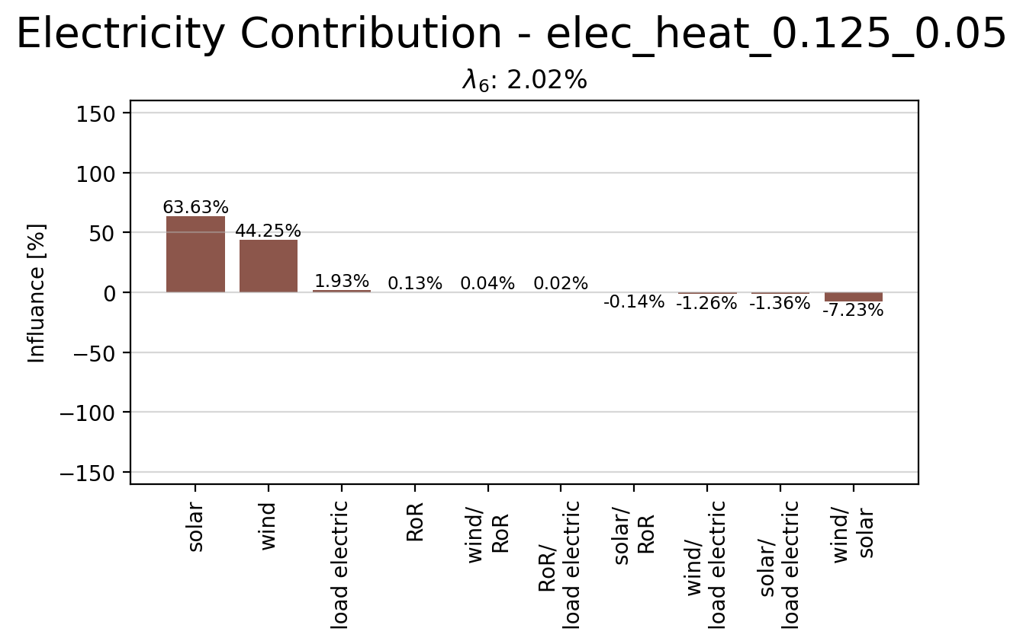
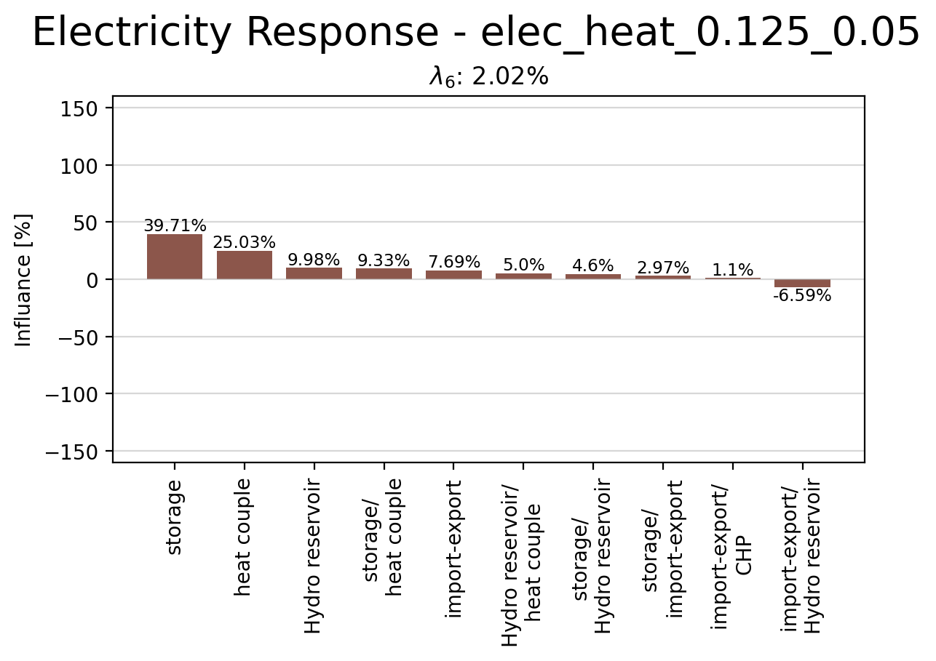
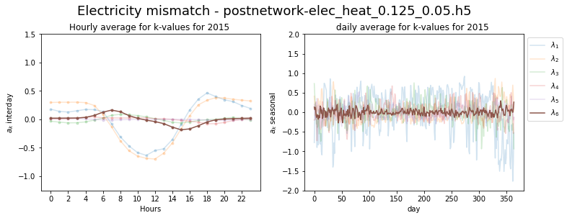
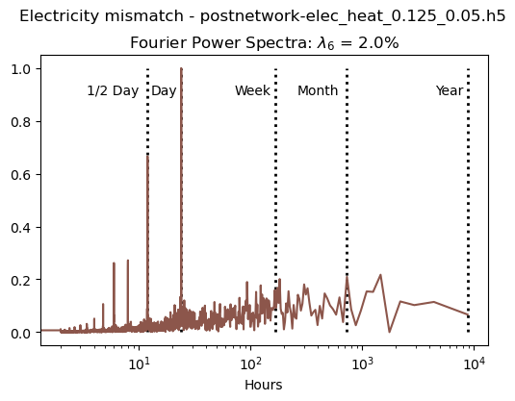
Principle Component 6

Slide 13
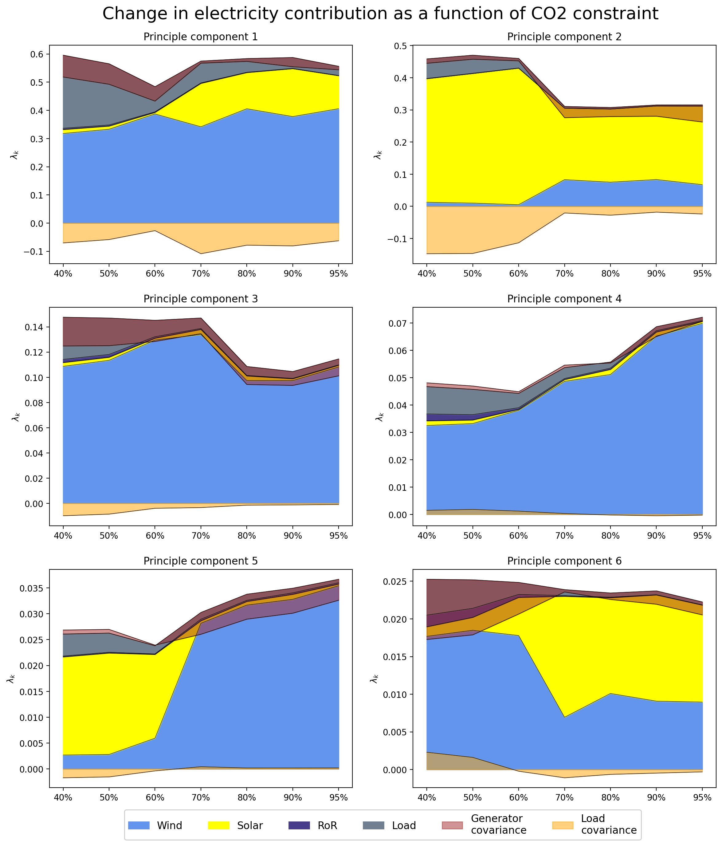
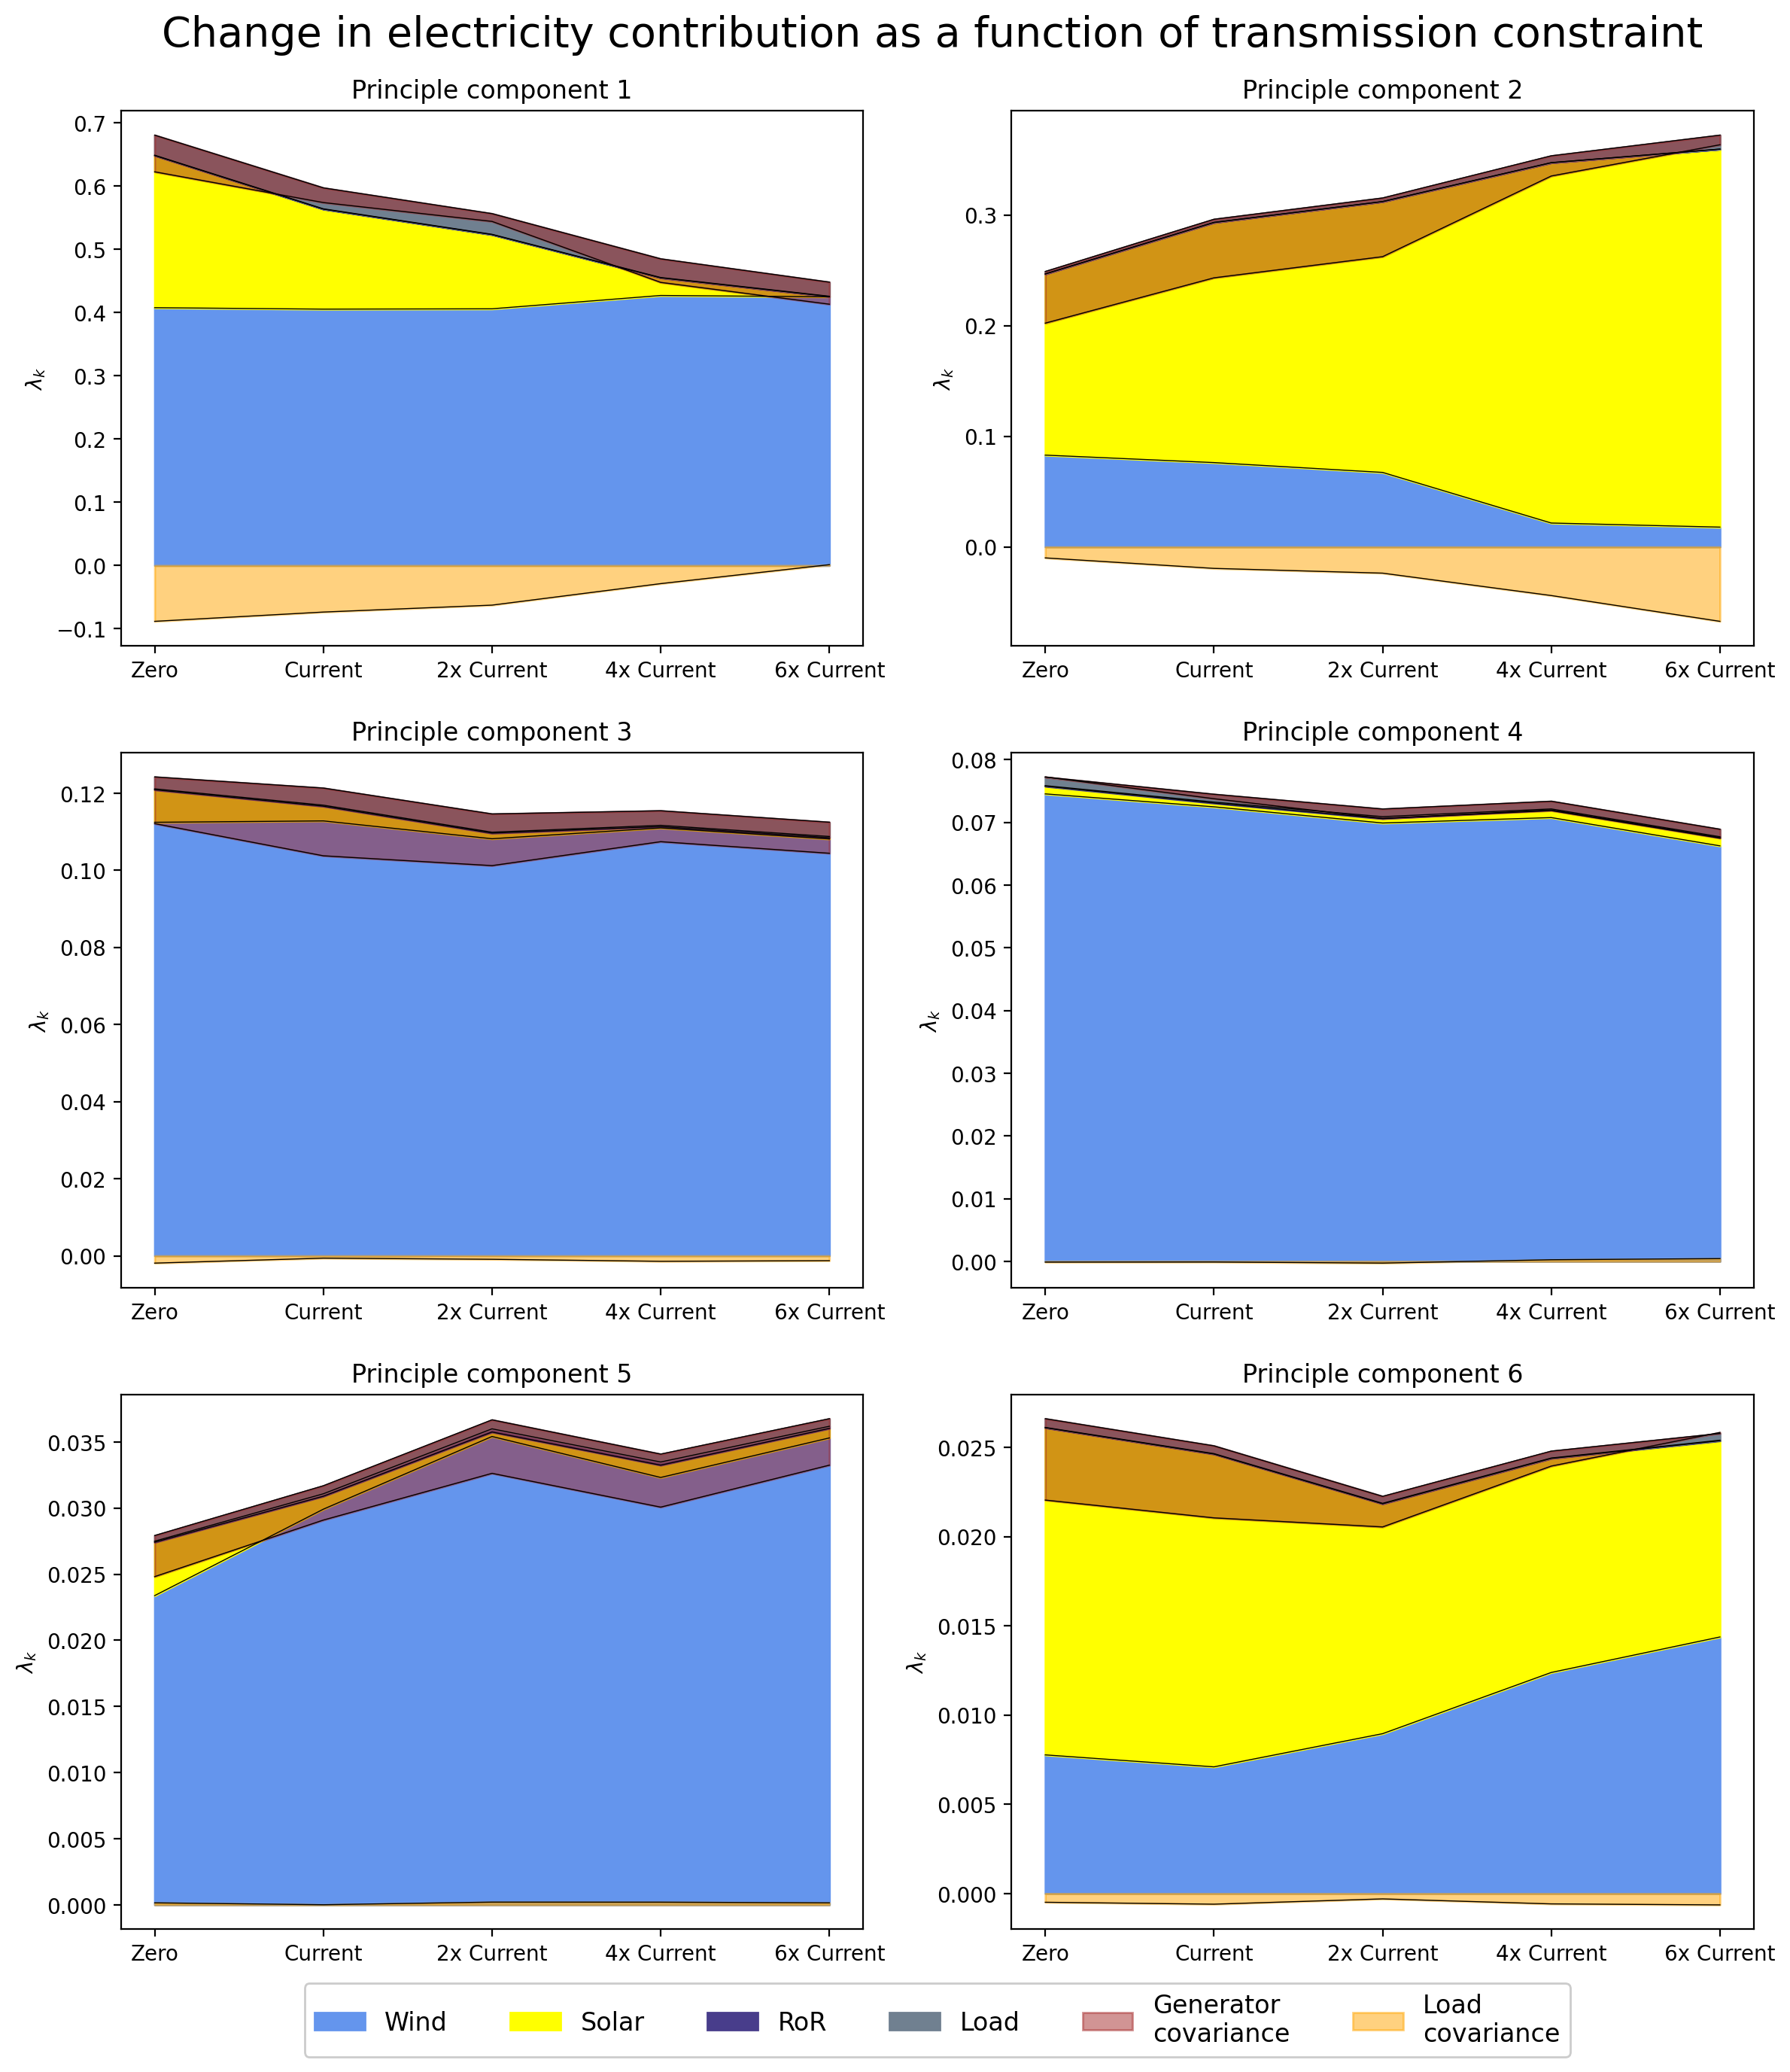
Change in Contribution due to CO2 and Transmission Constrain

Slide 14
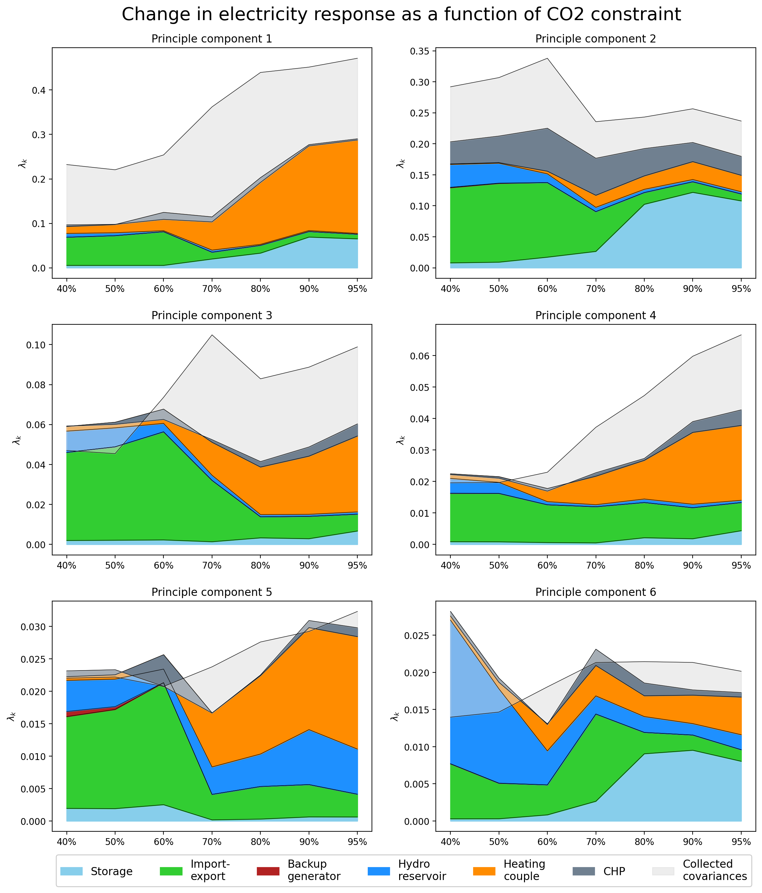
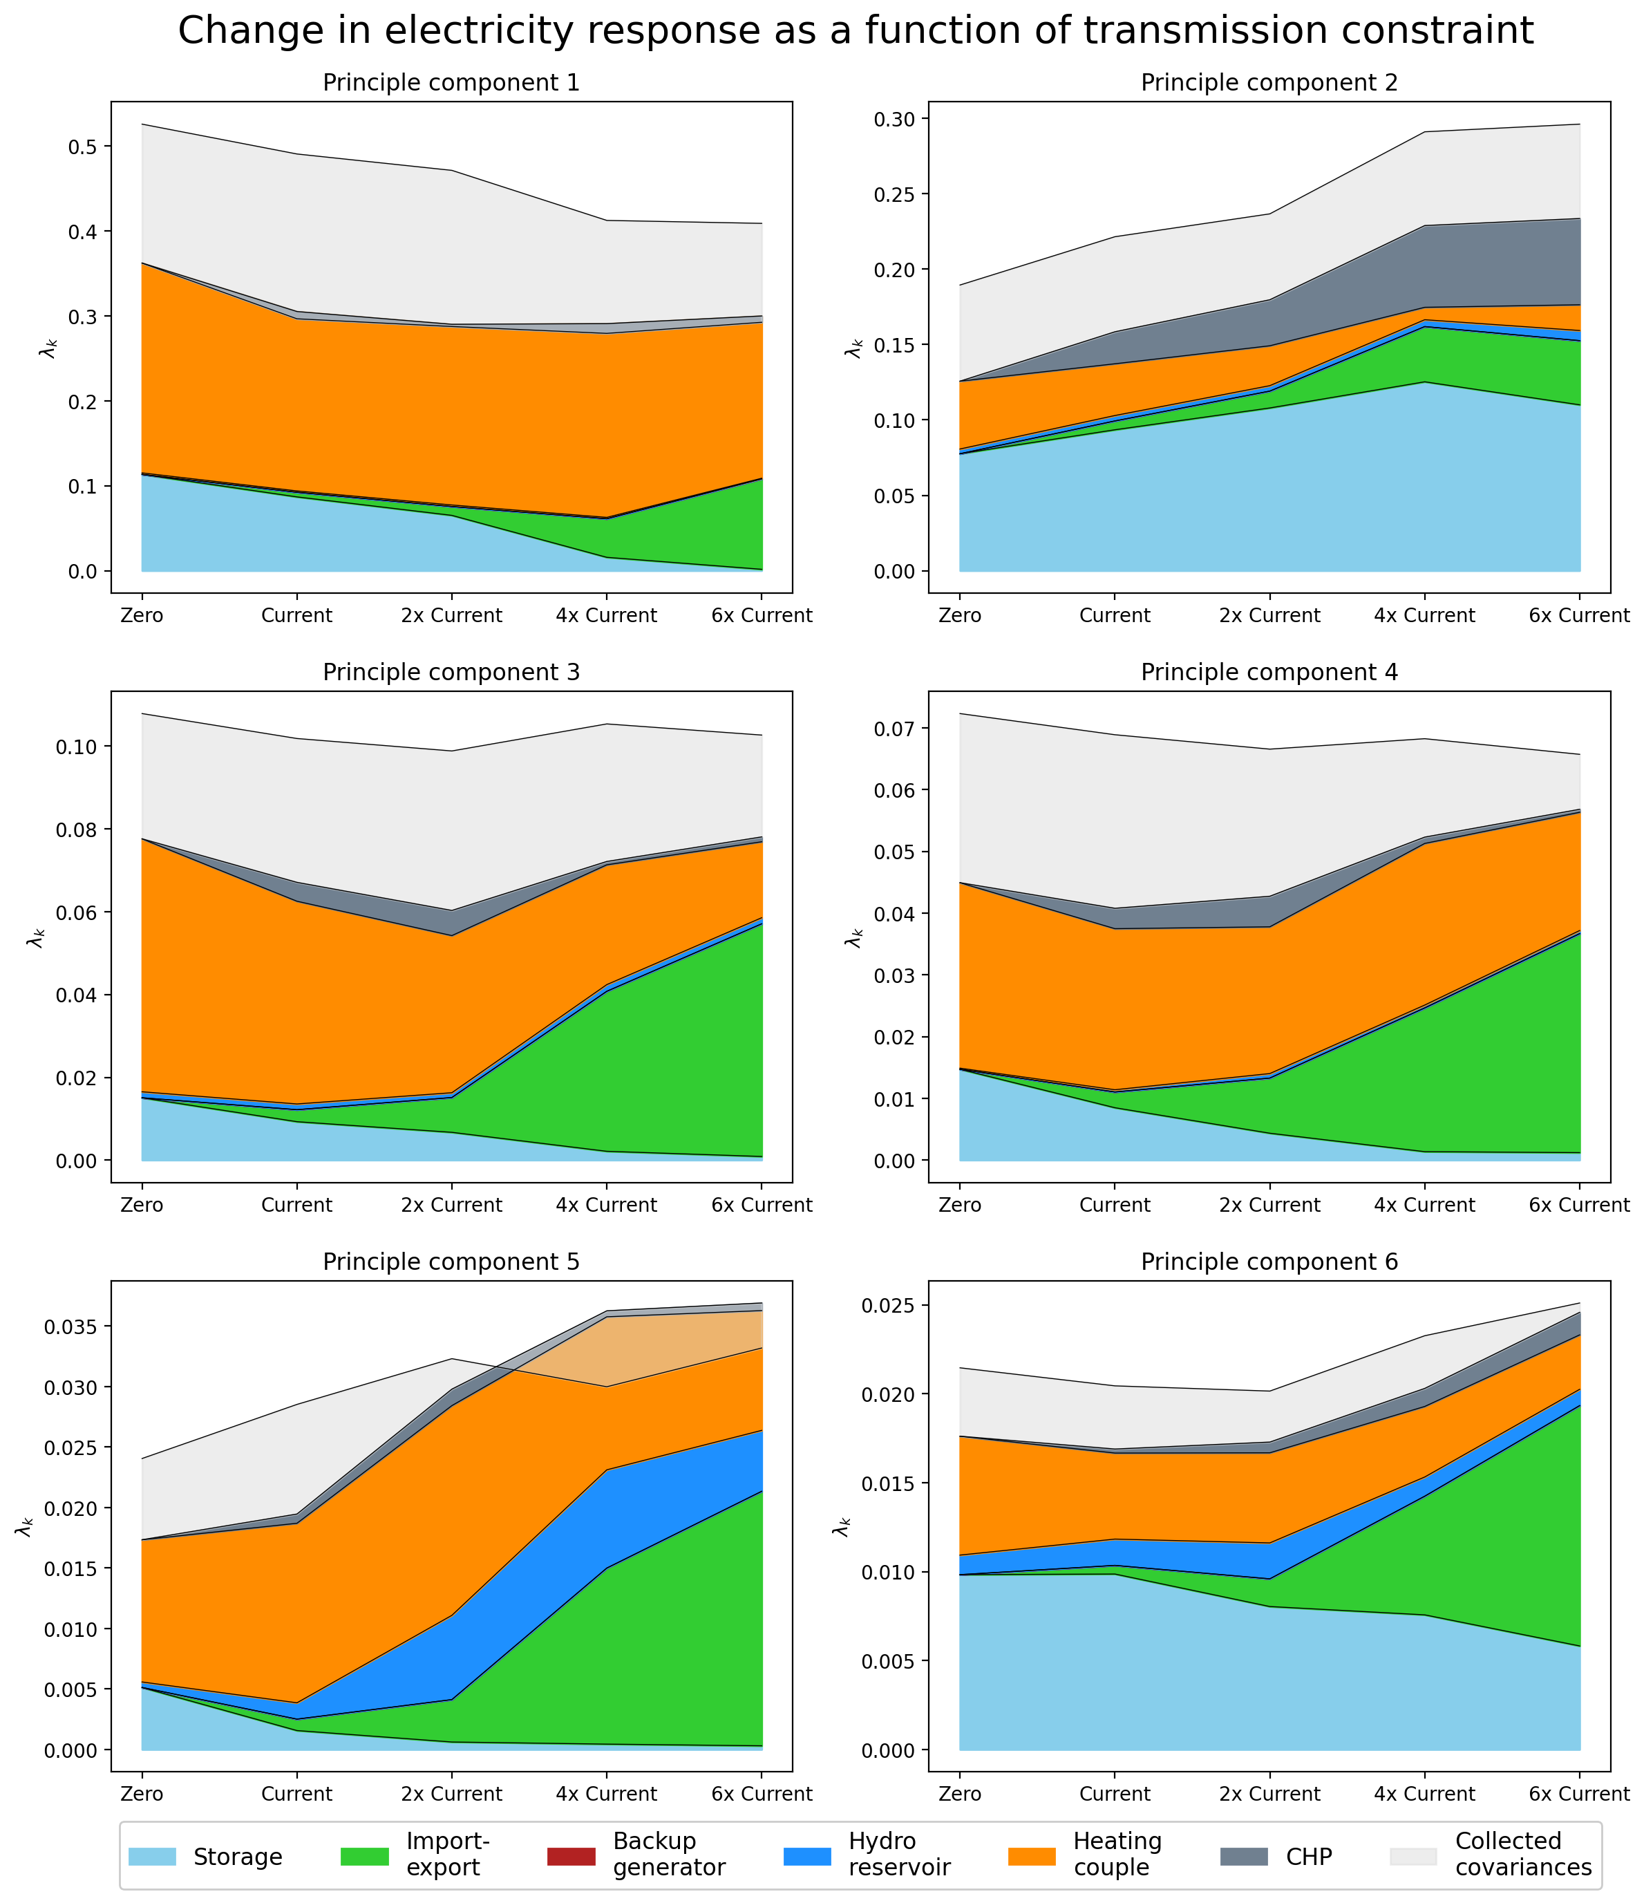
Change in Reponse due to CO2 and Transmission Constrain

Slide 15
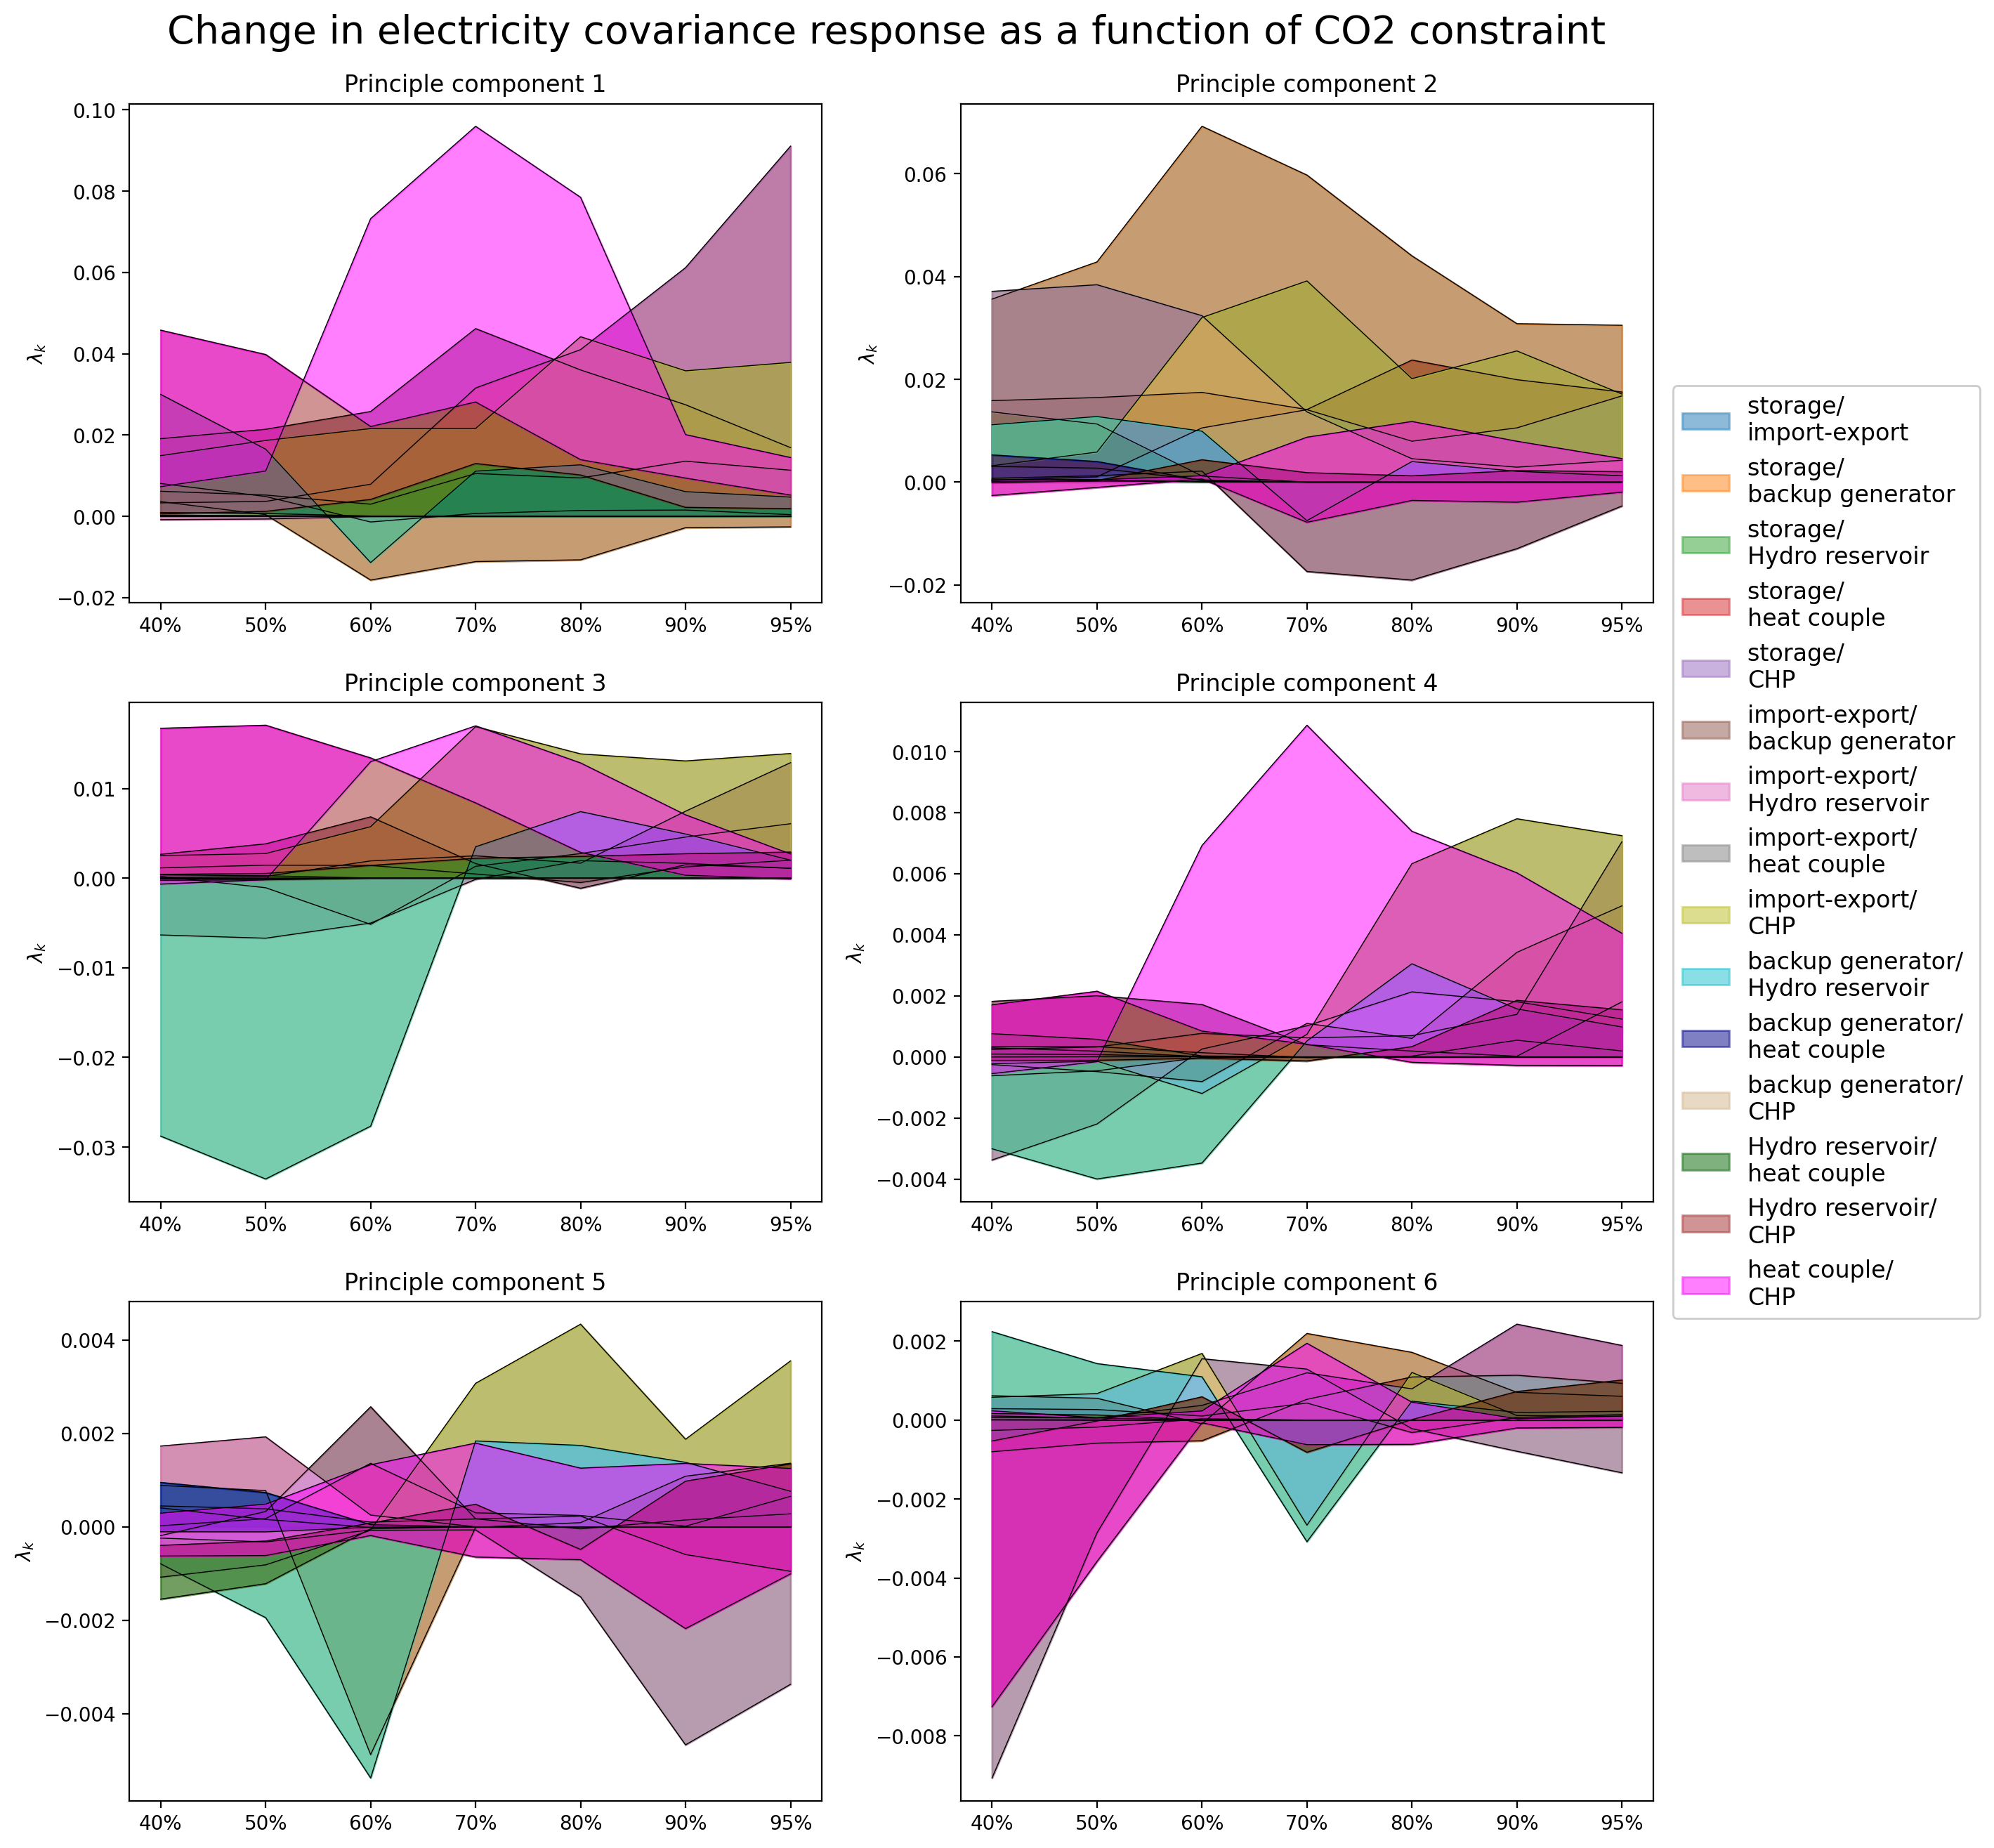
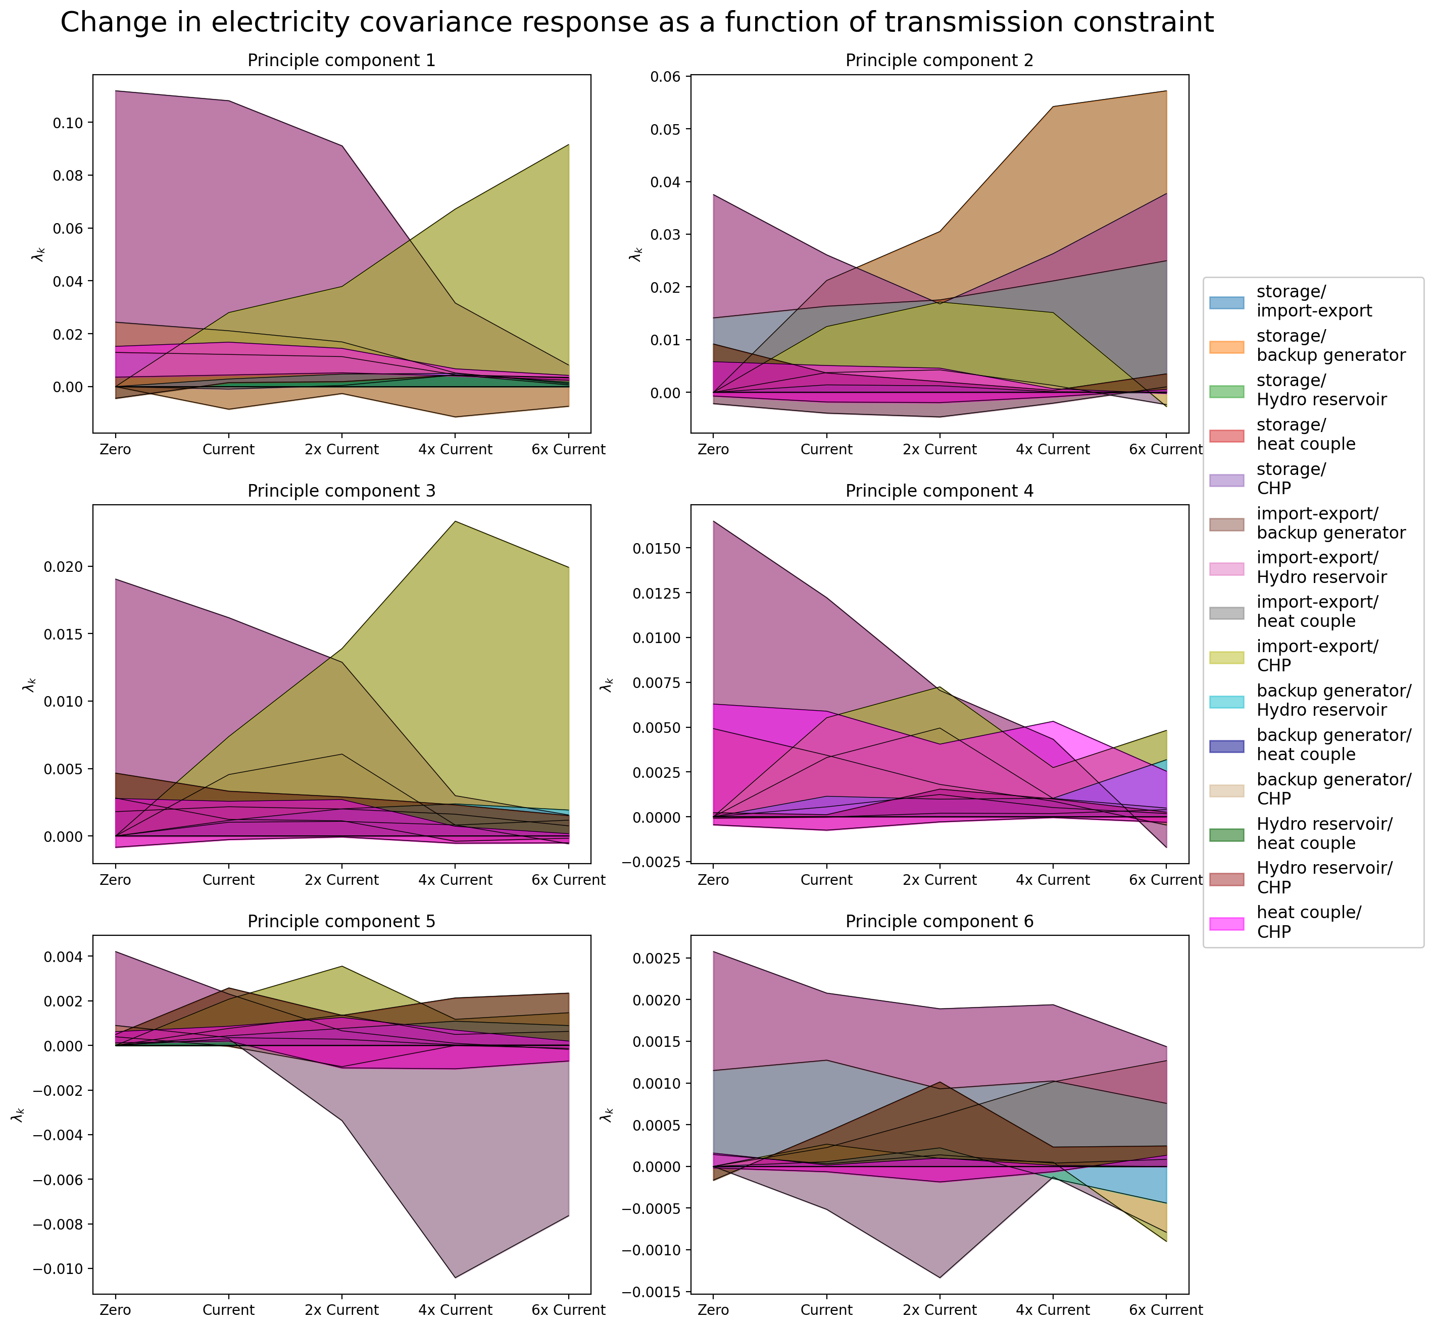
Change in Cov Reponse due to CO2 and Transmission Constrain

Slide 16
Electricity Coupled with the Heating Sector
Electricity NP Analysis

Slide 17
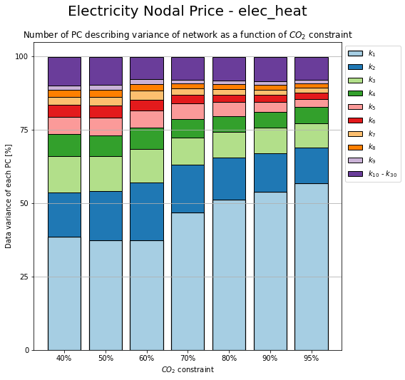
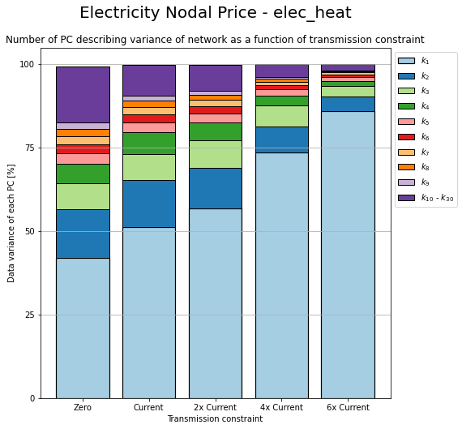
Change in PC due to CO2 and Transmission Constrain

Slide 18
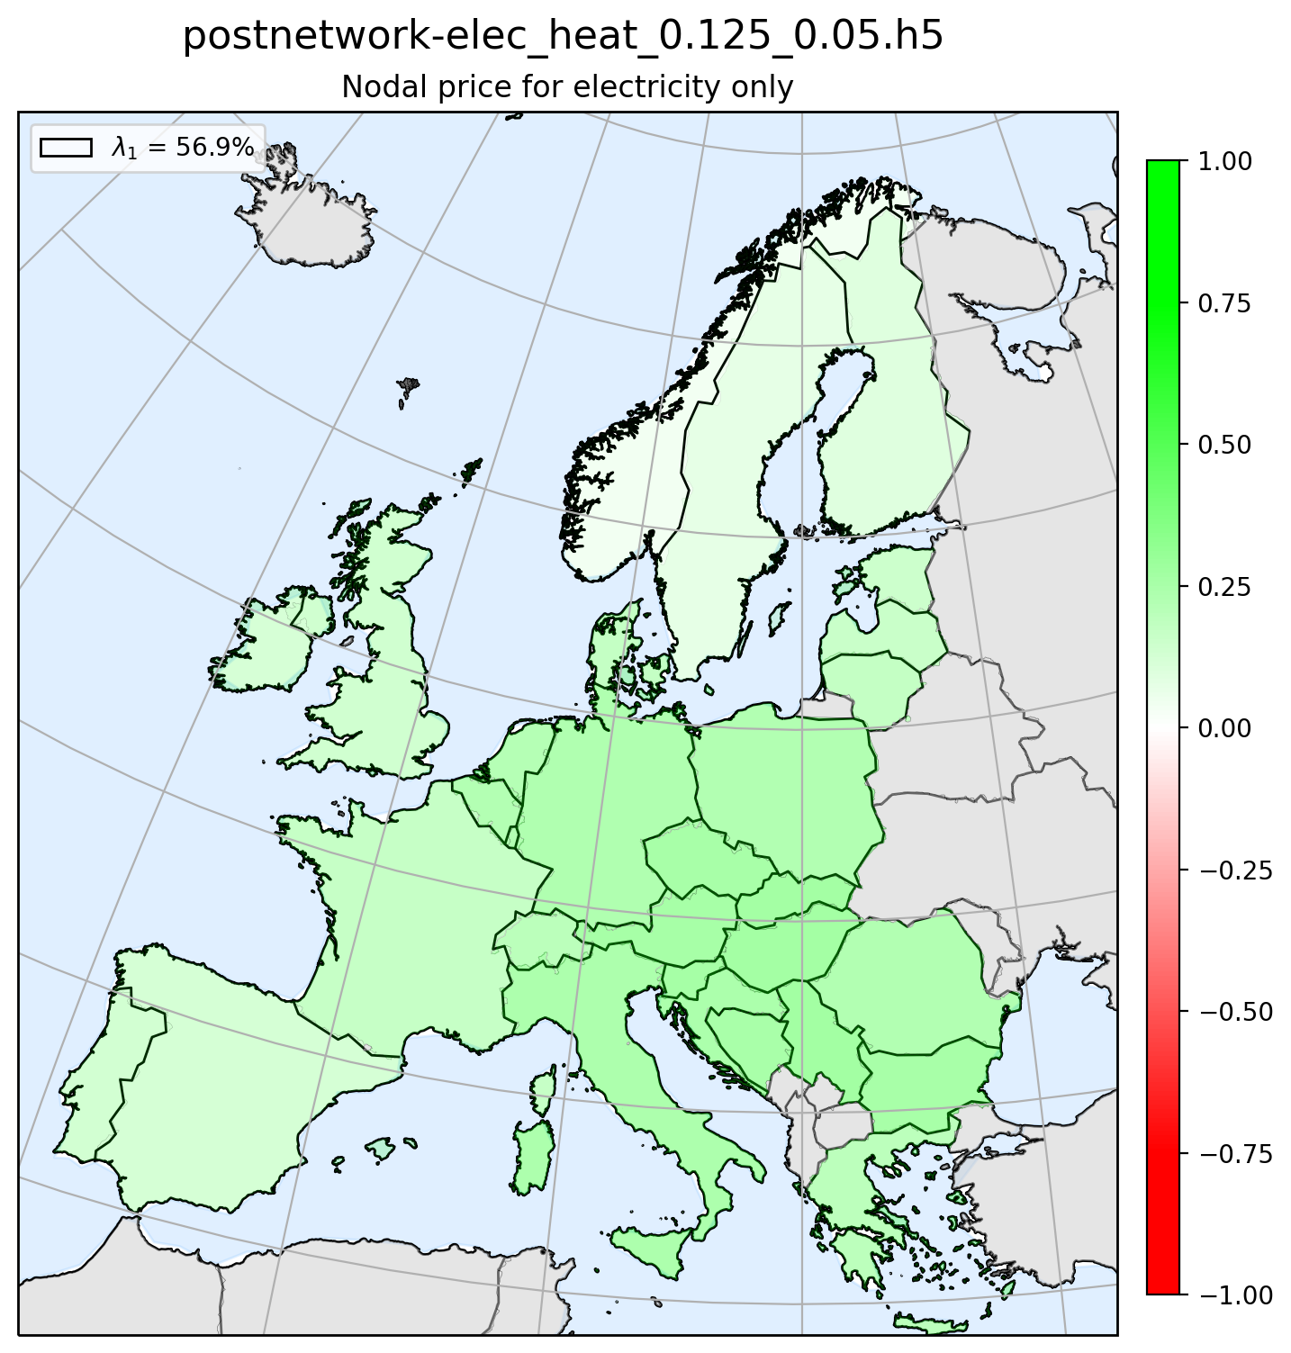
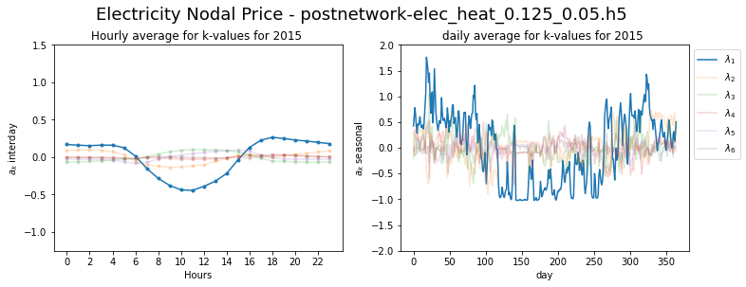
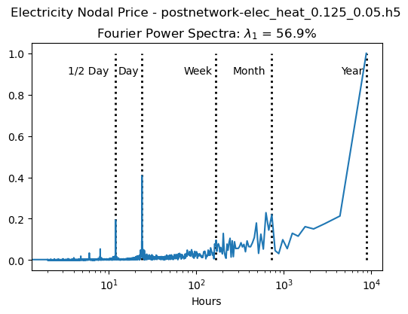
Principle Component 1

Slide 19
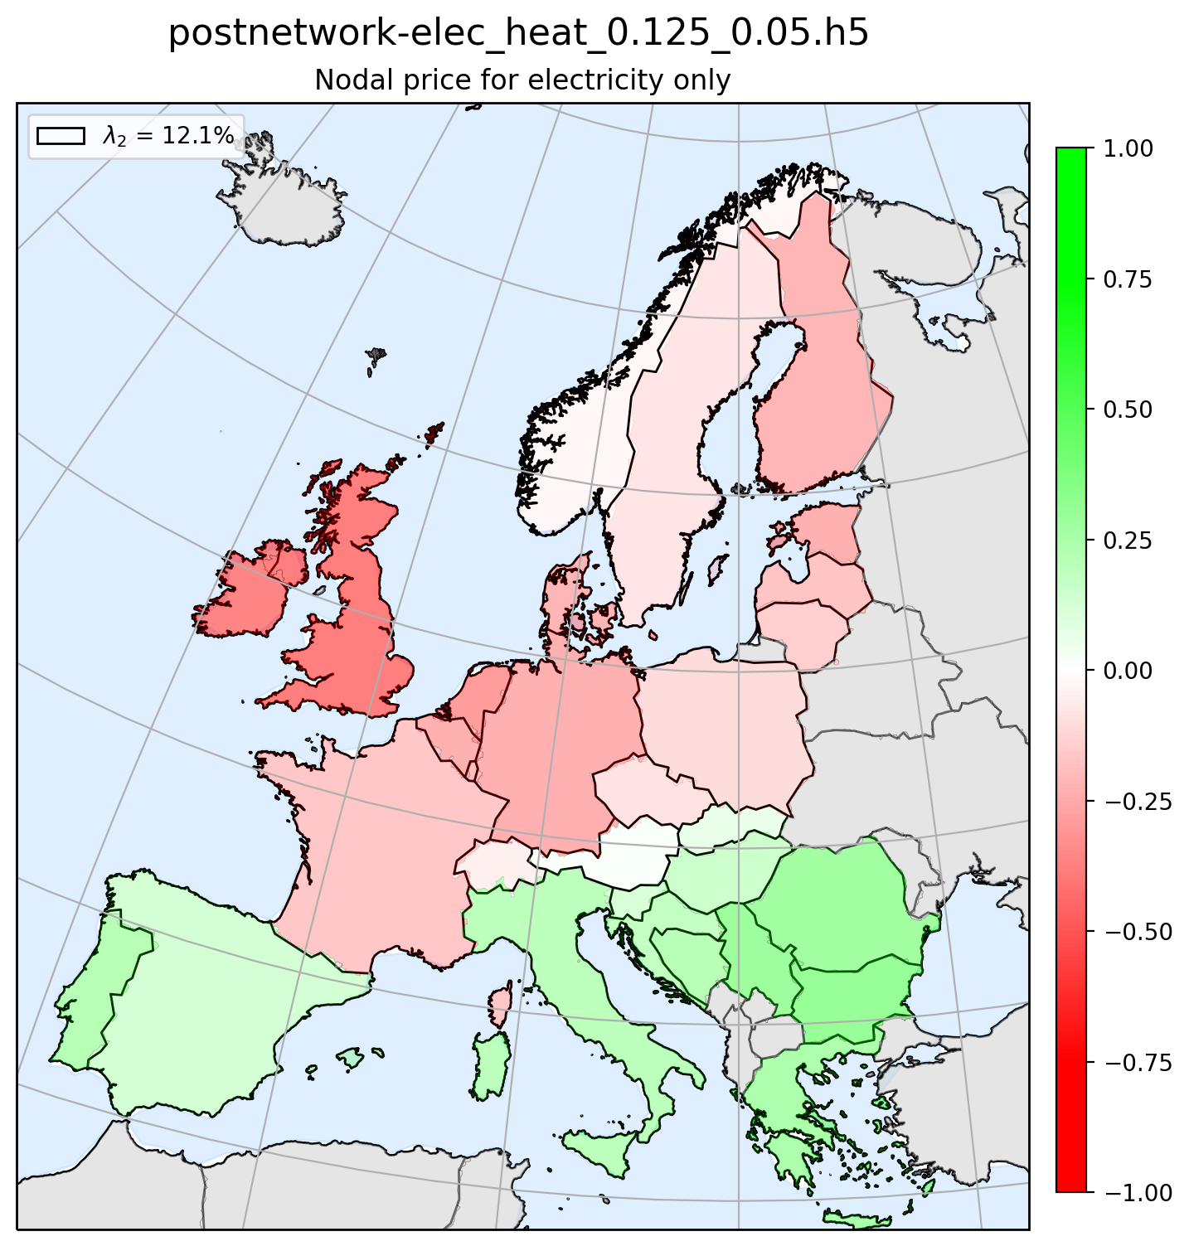
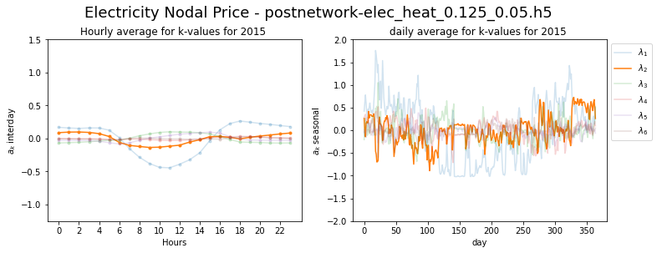
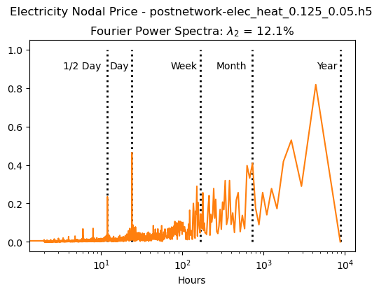
Principle Component 2

Slide 20



Principle Component 3

Slide 21



Principle Component 4

Slide 22



Principle Component 5

Slide 23



Principle Component 6

Slide 24
Electricity Coupled with the Heating Sector
Electricy Mismatch and NP Coherence

Slide 25

Coherence Method 1
Nodal Price
Mismatch
1)
2)
1)
2)
3)
4)
3)
4)
5)
6)
5)
6)

Slide 26

Coherence Method 2
Nodal Price
Mismatch
1)
2)
1)
2)
3)
4)
3)
4)
5)
6)
5)
6)

Slide 27

Coherence Method 3
Nodal Price
Mismatch
1)
2)
1)
2)
3)
4)
3)
4)
5)
6)
5)
6)

Slide 28
Electricity Coupled with the Heating Sector
Heating Mismatch Analysis

Slide 29

Installed capacity

Slide 30

Heating Supplied by Different Technologies

Slide 31

Installed storage (energy capacity)

Slide 32

Installed storage (power capacity)

Slide 33


Change in PC due to CO2 and Transmission Constrain

Slide 34





Principle Component 1

Slide 35





Principle Component 2

Slide 36





Principle Component 3

Slide 37





Principle Component 4

Slide 38





Principle Component 5

Slide 39





Principle Component 6

Slide 40


Change in Contribution due to CO2 and Transmission Constrain

Slide 41


Change in Reponse due to CO2 and Transmission Constrain

Slide 42


Change in Cov Reponse due to CO2 and Transmission Constrain

Slide 43
Electricity Coupled with the Heating Sector
Heating NP Analysis

Slide 44


Change in PC due to CO2 and Transmission Constrain

Slide 45



Principle Component 1

Slide 46



Principle Component 2

Slide 47



Principle Component 3

Slide 48



Principle Component 4

Slide 49



Principle Component 5

Slide 50



Principle Component 6

Slide 51
Electricity Coupled with the Heating Sector
Heating Mismatch and NP Coherence

Slide 52

Coherence Method 1
Nodal Price
Mismatch
1)
2)
1)
2)
3)
4)
3)
4)
5)
6)
5)
6)

Slide 53

Coherence Method 2
Nodal Price
Mismatch
1)
2)
1)
2)
3)
4)
3)
4)
5)
6)
5)
6)

Slide 54

Coherence Method 3
Nodal Price
Mismatch
1)
2)
1)
2)
3)
4)
3)
4)
5)
6)
5)
6)

Slide 55
Electricity Coupled with the Heating Sector
Electricity NP and Heating and NP Coherence

Slide 56

Coherence Method 1
HNP
ENP
1)
2)
1)
2)
3)
4)
3)
4)
5)
6)
5)
6)

Slide 57

Coherence Method 2
HNP
ENP
1)
2)
1)
2)
3)
4)
3)
4)
5)
6)
5)
6)

Slide 58

Coherence Method 3
HNP
ENP
1)
2)
1)
2)
3)
4)
3)
4)
5)
6)
5)
6)

